Slide 1
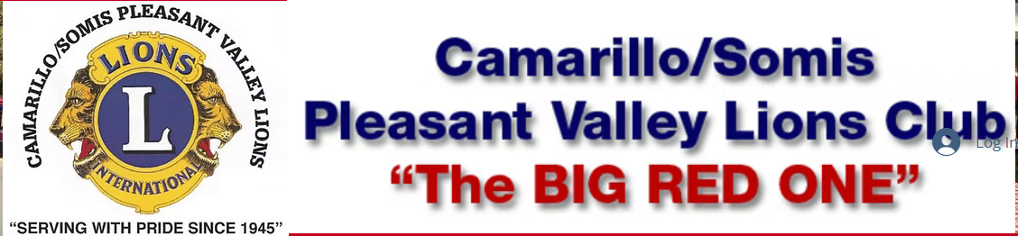
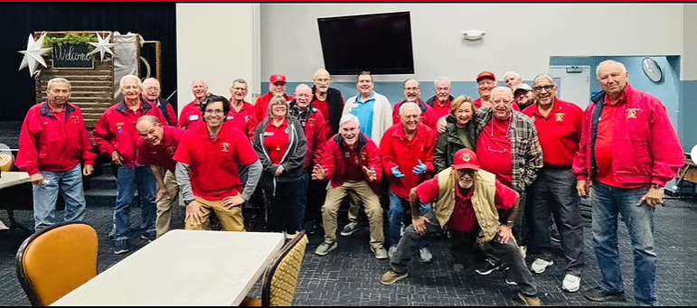

Slide 2
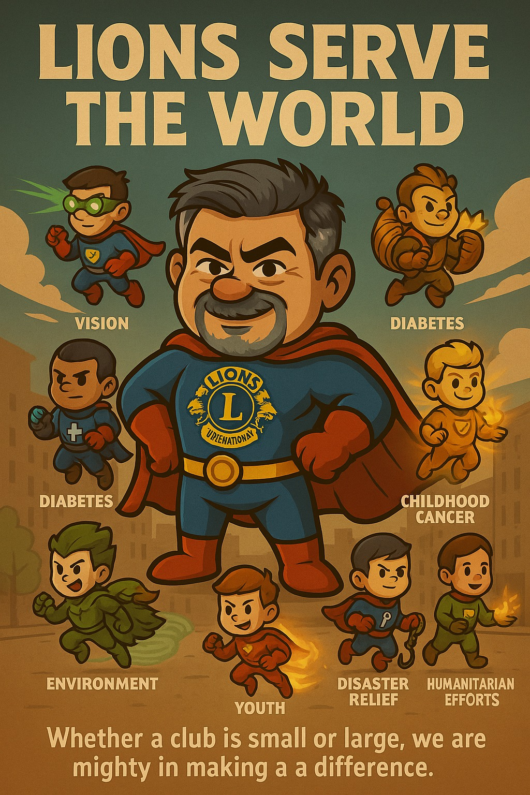
Lions Clubs are primarily a service organization that focuses on improving communities and supporting those in need, both locally and globally. Their core mission is to "empower Lions clubs, volunteers, and partners to improve health and wellbeing, strengthen communities, and support those in need". They achieve this through a variety of initiatives, including vision and hearing conservation, youth programs, disaster relief, and support for the visually and hearing-impaired.

Slide 3
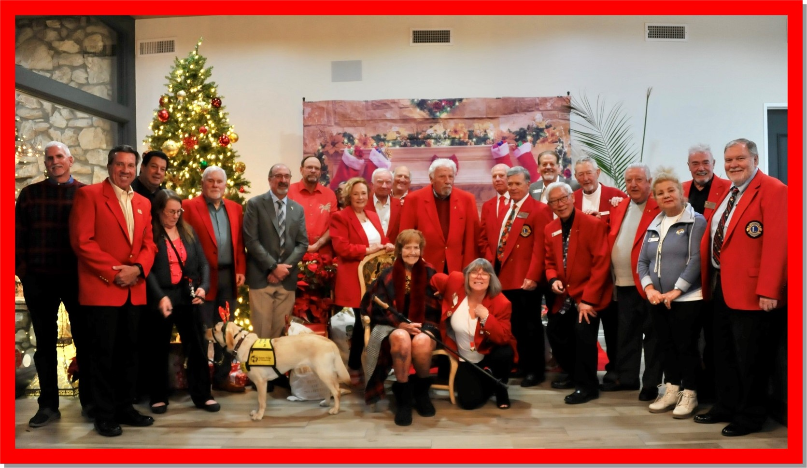
Christmas Party - 2023

Slide 4
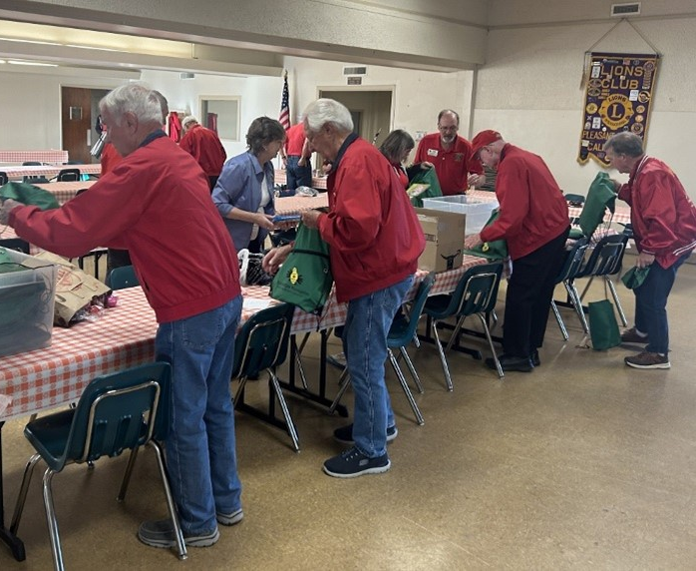
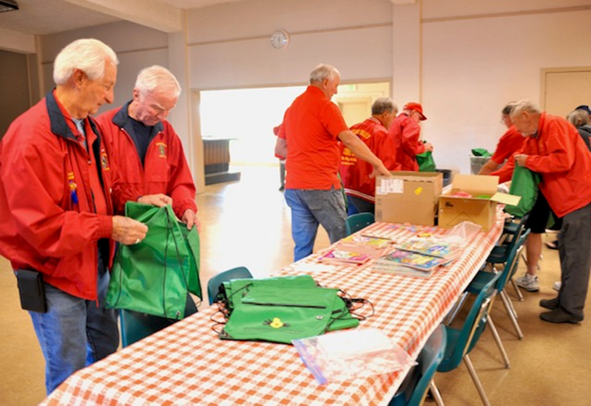
Food Share Distribution

Slide 5
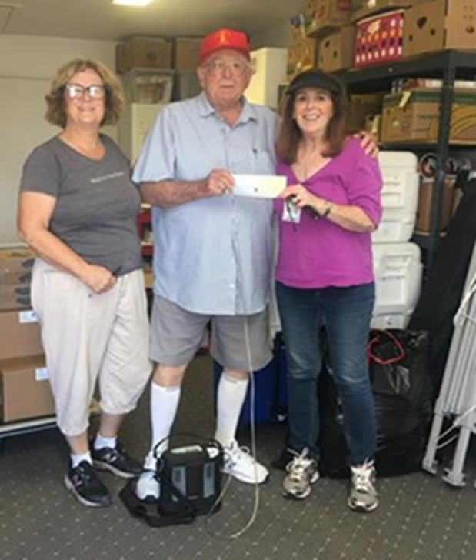
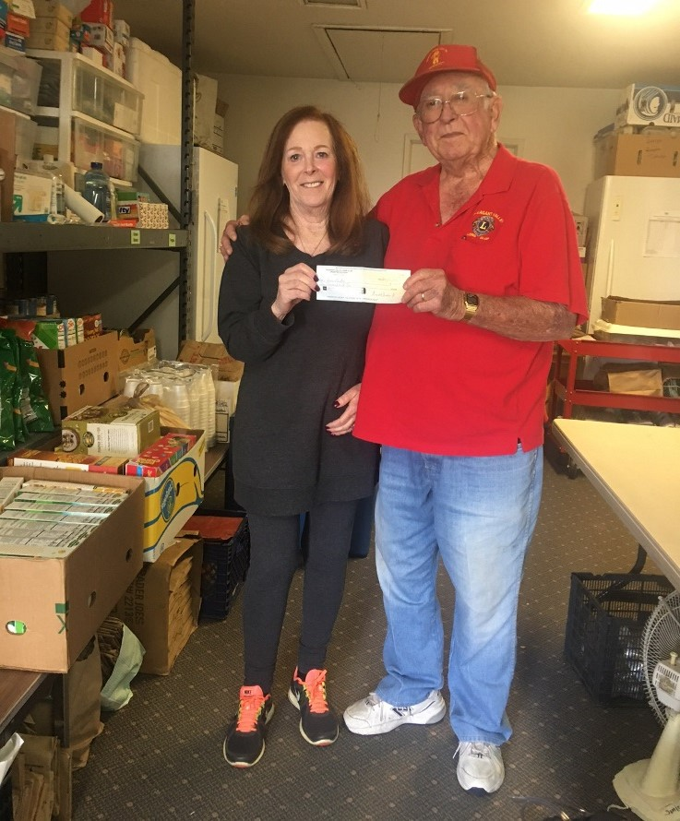
Somis Pantry Donations

Slide 6
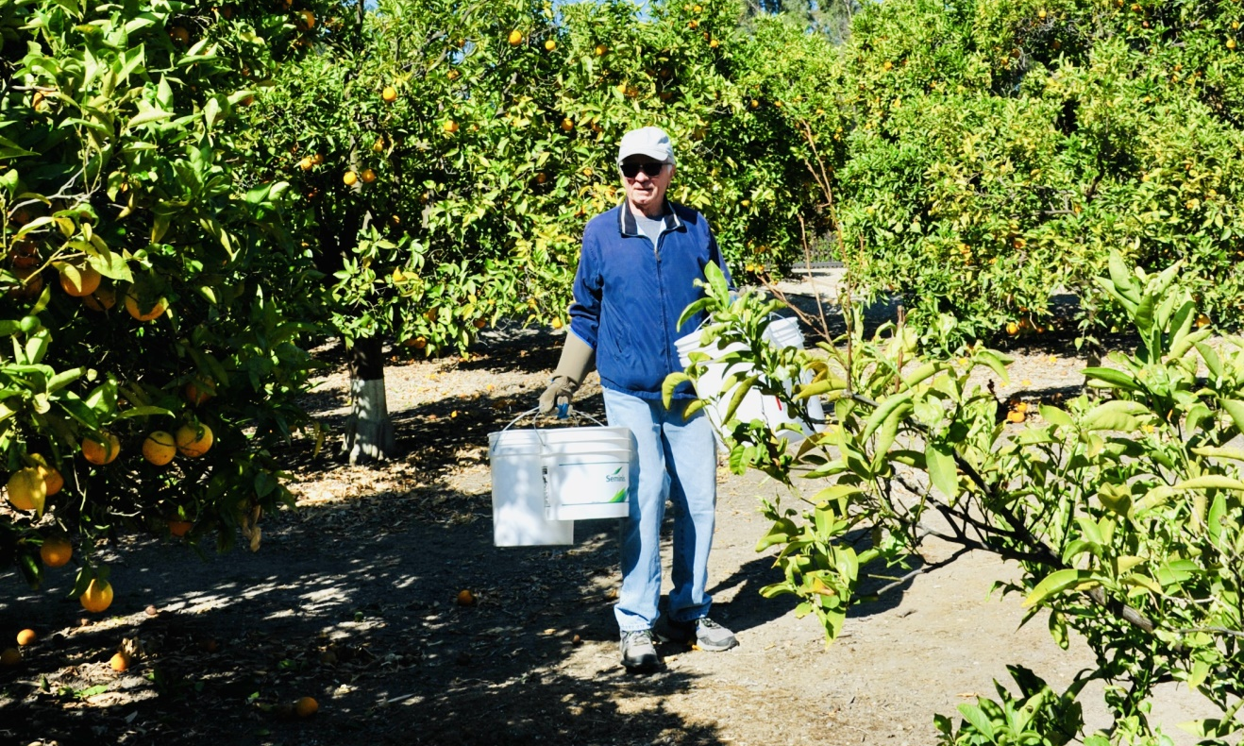
Picking Oranges at Lion Ling’s Ranch for Food Share

Slide 7
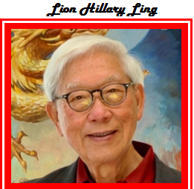

Slide 8
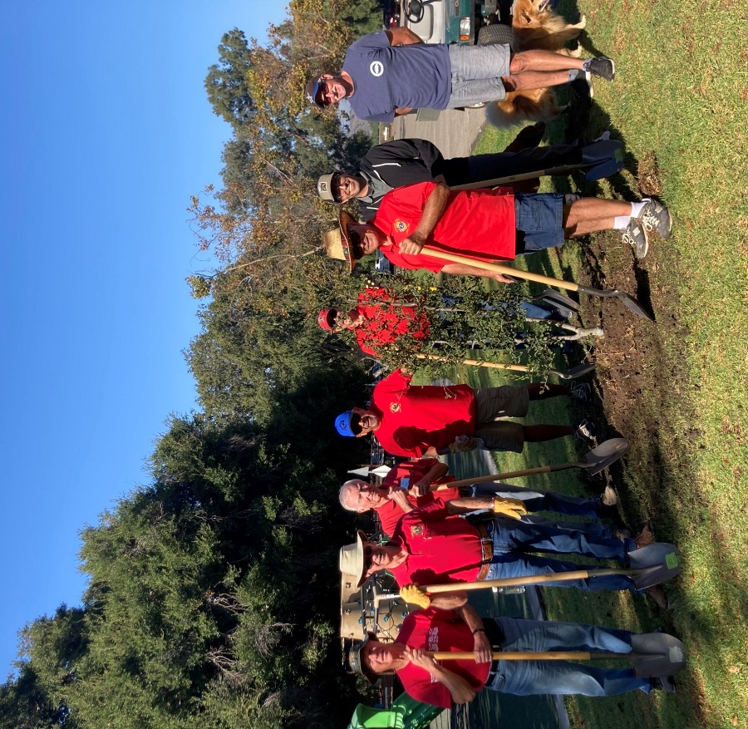
Tree Planting for Recs & Parks

Slide 9
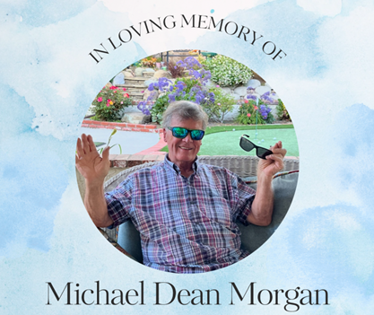

Slide 10
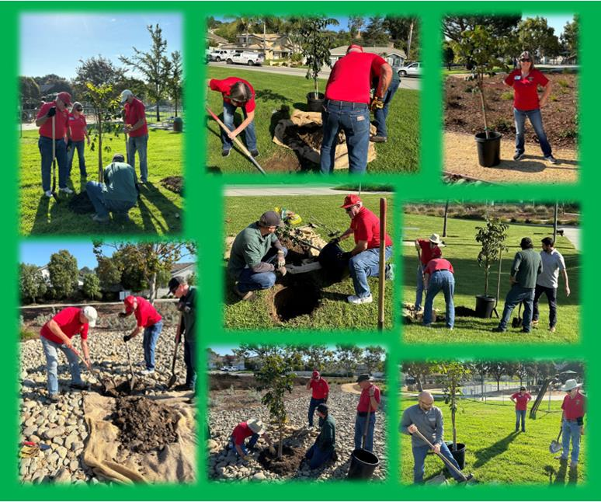
Tree Planting at Locker Park

Slide 11
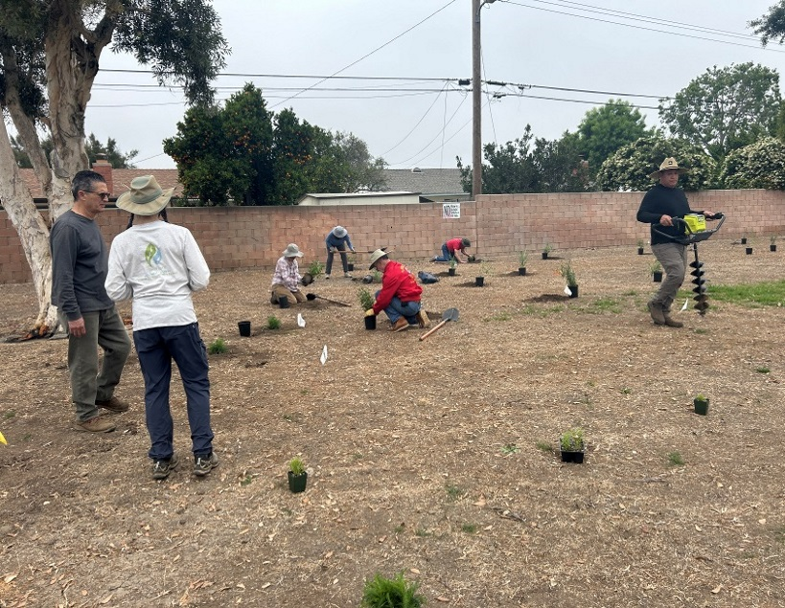
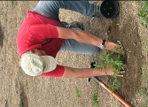
Dozens of Shrubs Planted

Slide 12
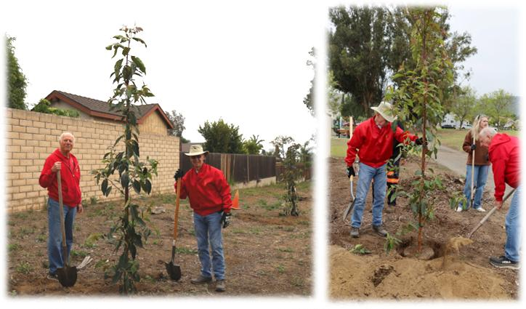
Tree Planting for Recs & Parks @ Charter Oak Park

Slide 13
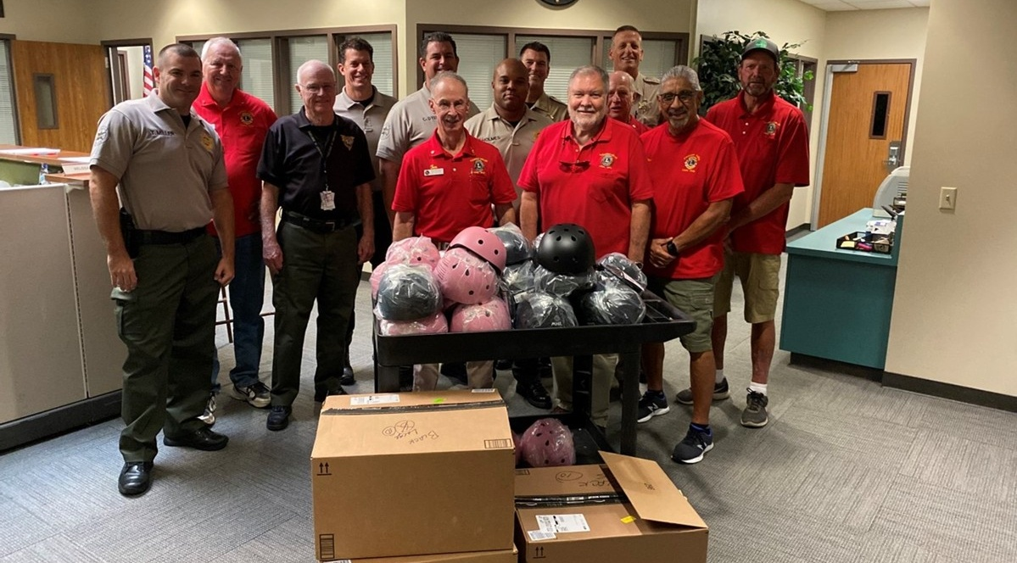
Kids Helmets for Camarillo Police

Slide 14


Slide 15
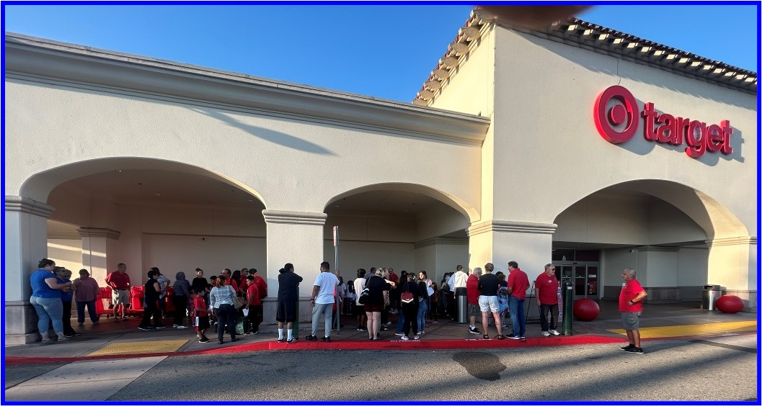
Kids Shopping Spree

Slide 16
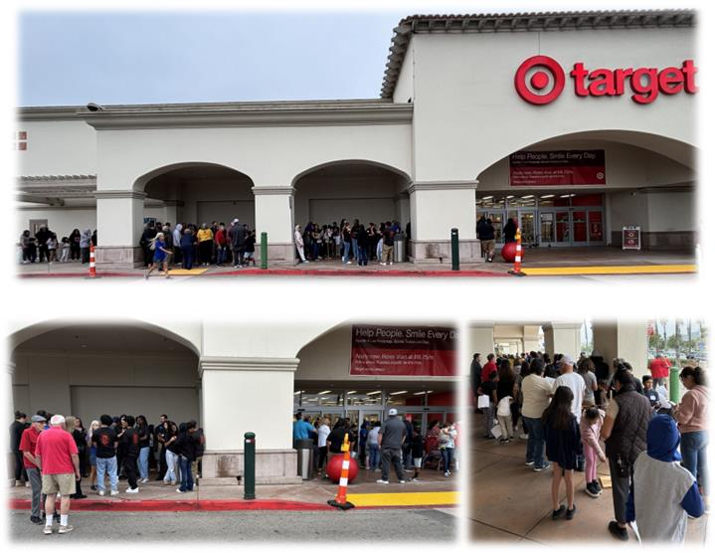
Kids Shopping Spree

Slide 17
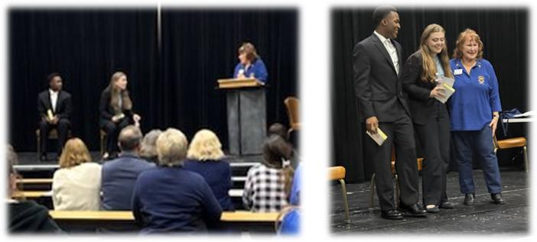
Student Speaker Contest

Slide 18
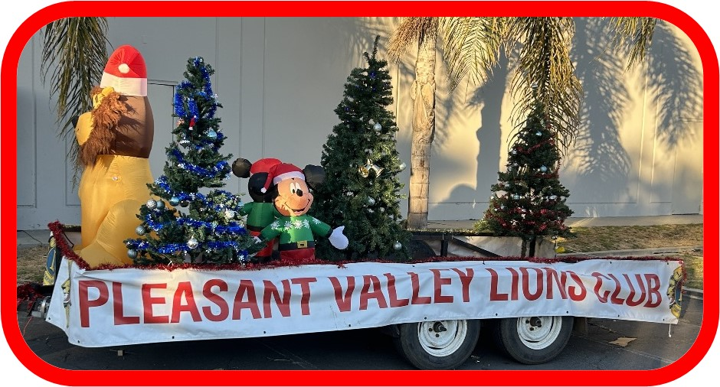
Christmas Float - The one that blew away!!

Slide 19
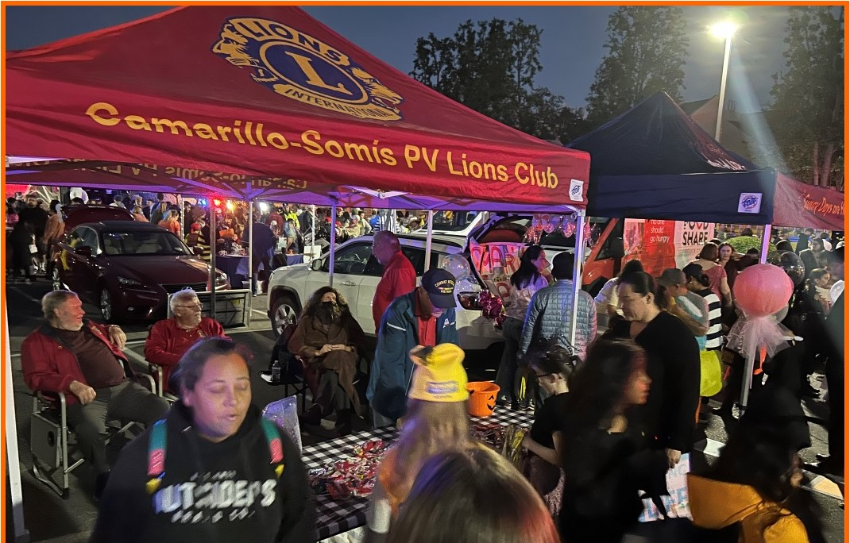

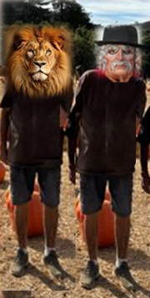
Cam Police Dept. Trunk or Treat Halloween

Slide 20


Slide 21
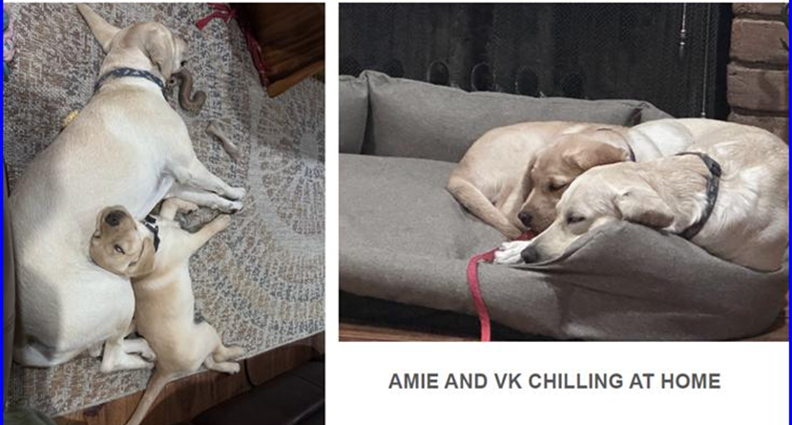

Slide 22
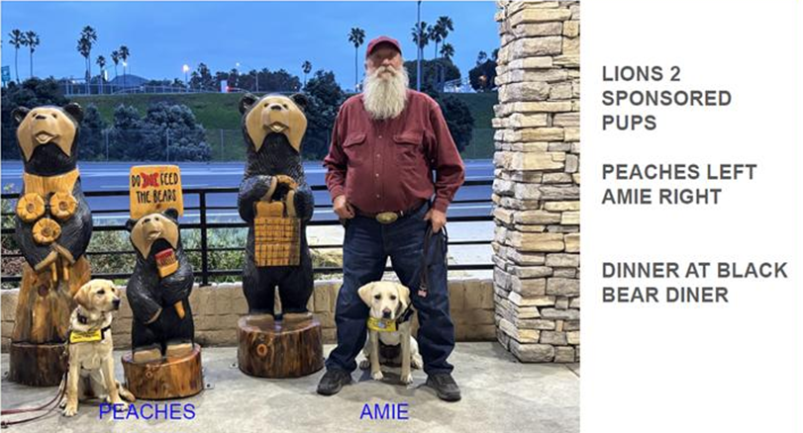

Slide 23
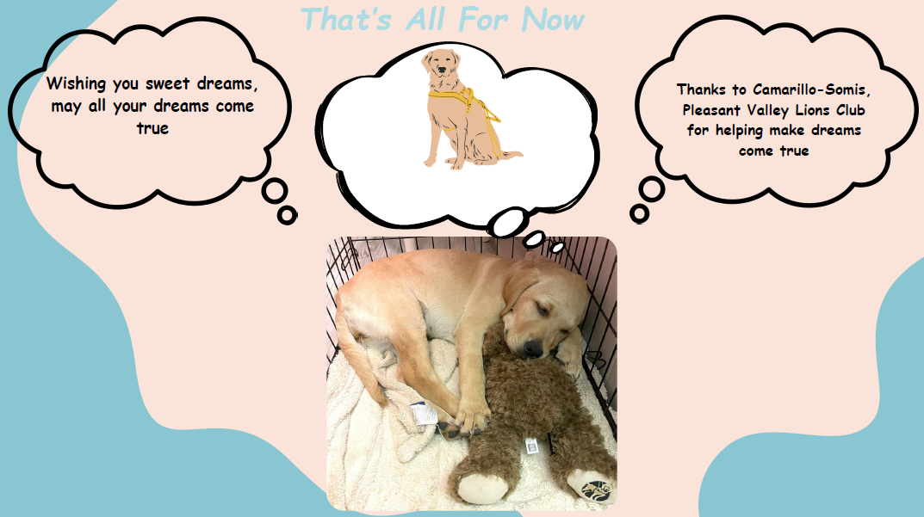
Peaches

Slide 24
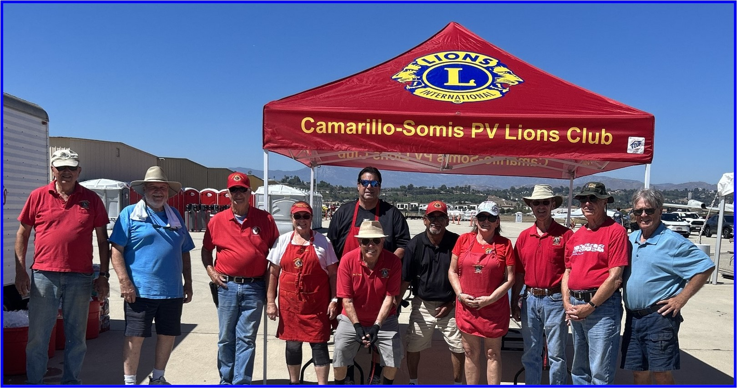
Wings over Camarillo BBQ

Slide 25
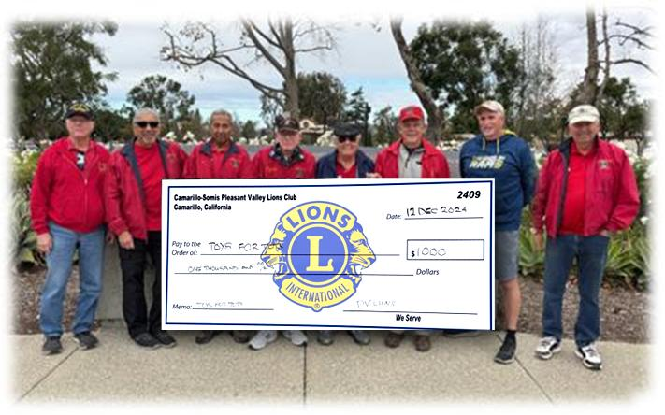
Toys for Tots Donation
Toys for Tots

Slide 26
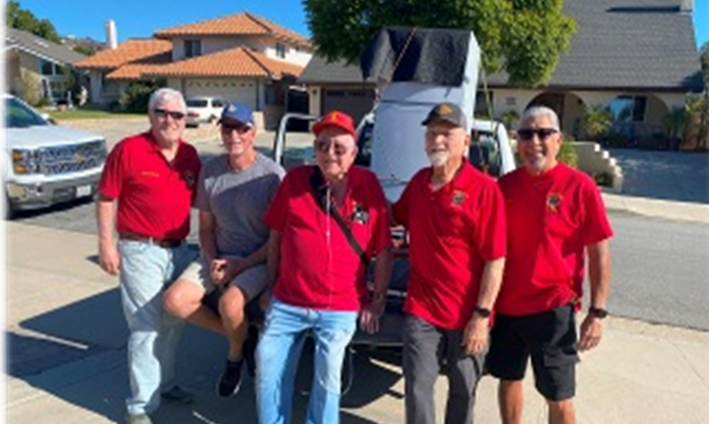
PV Delivers for Mountain Fire Victims

Slide 27
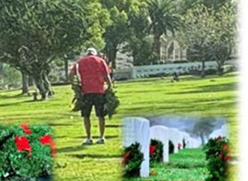
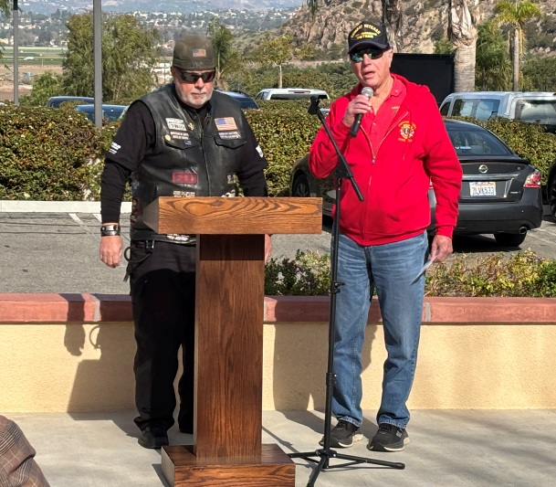
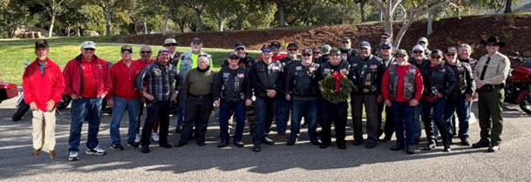
Pleasant Valley Delivers Donation and Lays Wreaths at Conejo Valley Cemetery

Slide 28
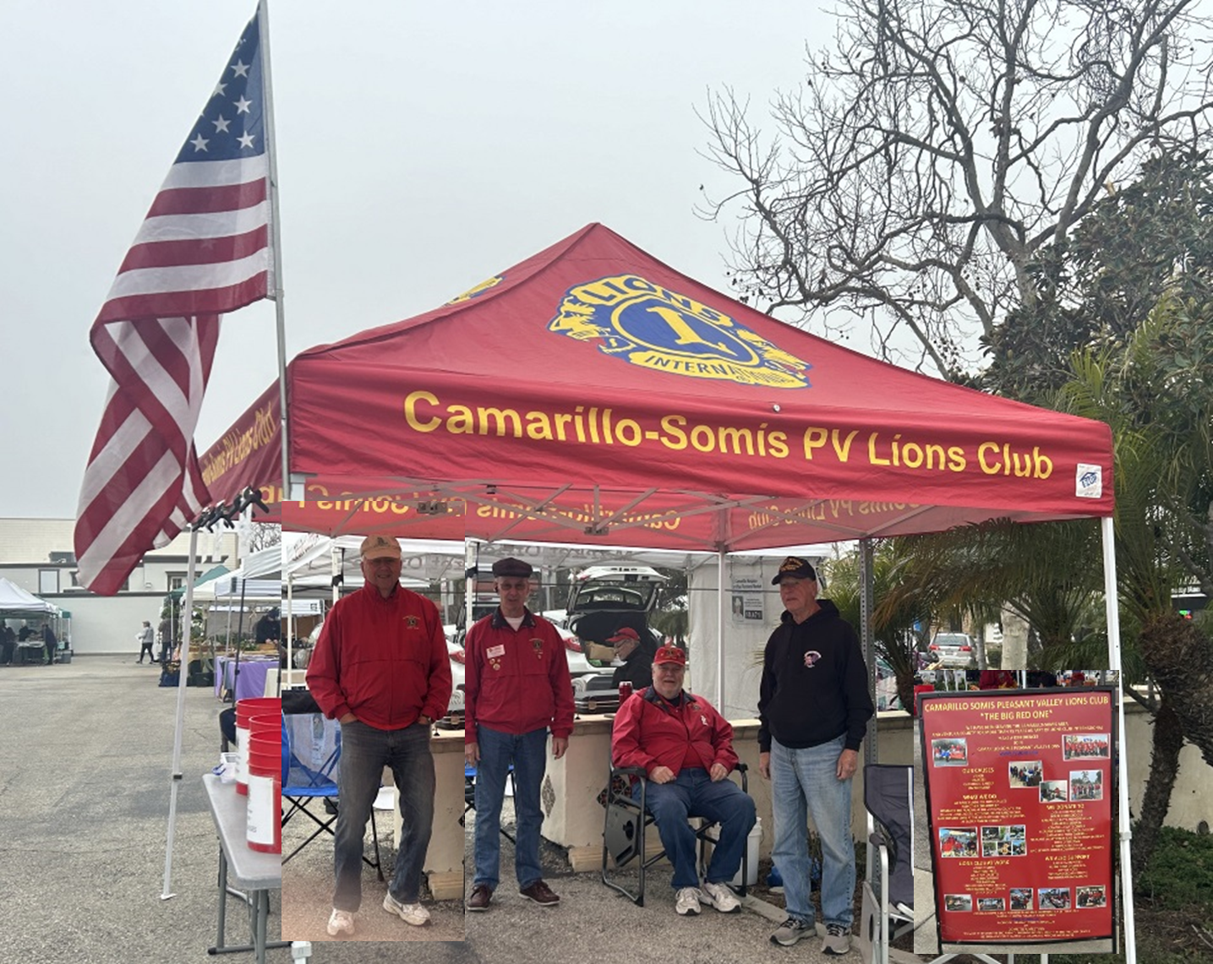
Farmers Market - Camarillo

Slide 29
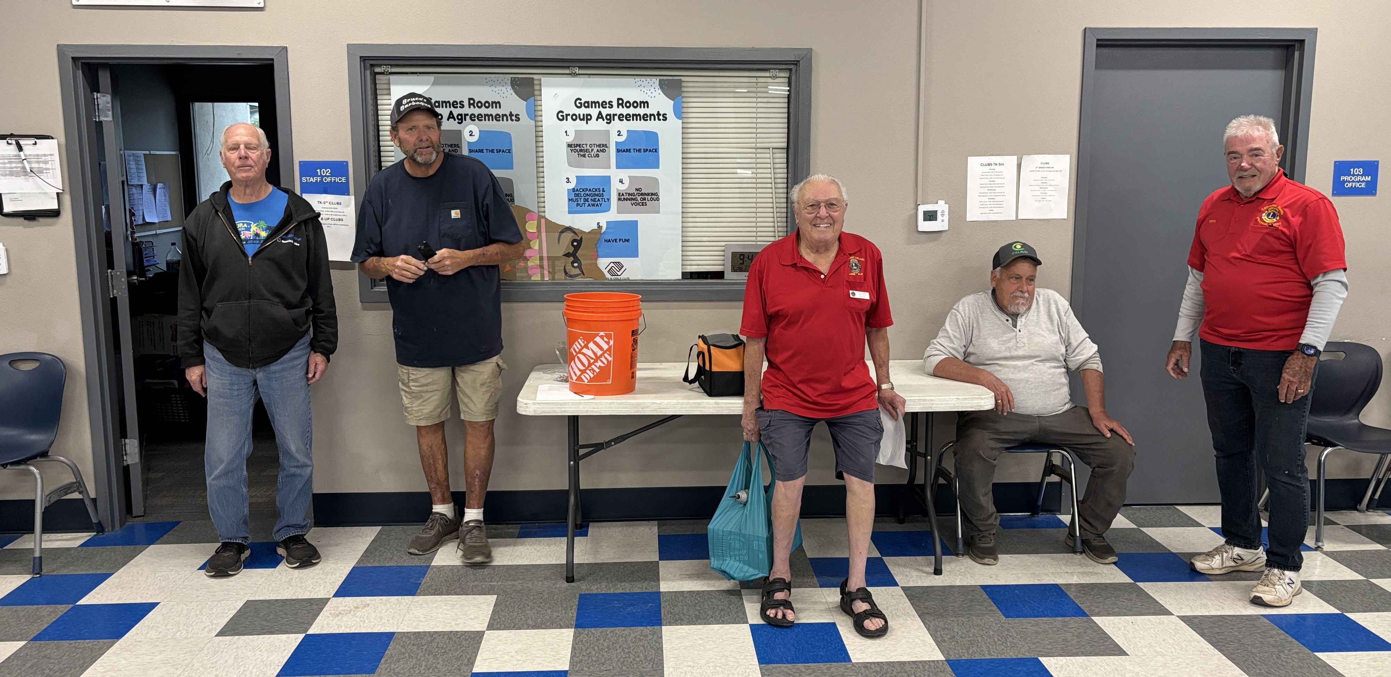
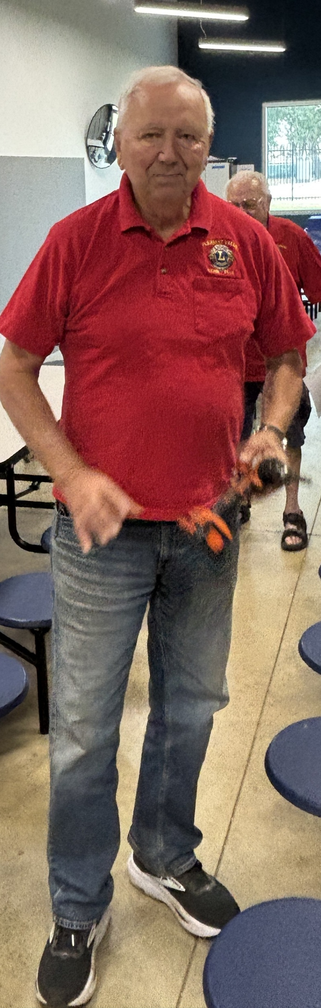
Boys & Girls Club Maintenance

Slide 30
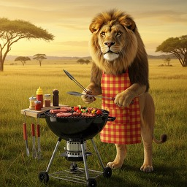
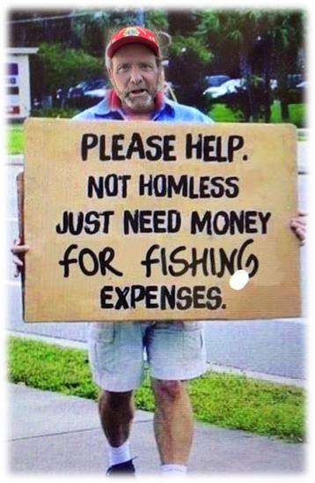
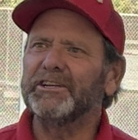

Slide 31
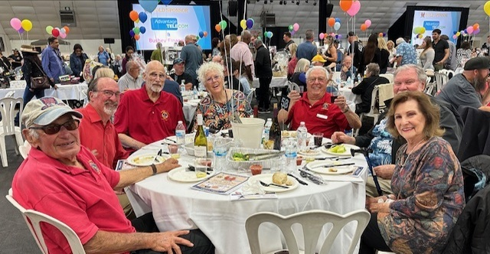
Ventura Downtown Lions Crab Fest

Slide 32
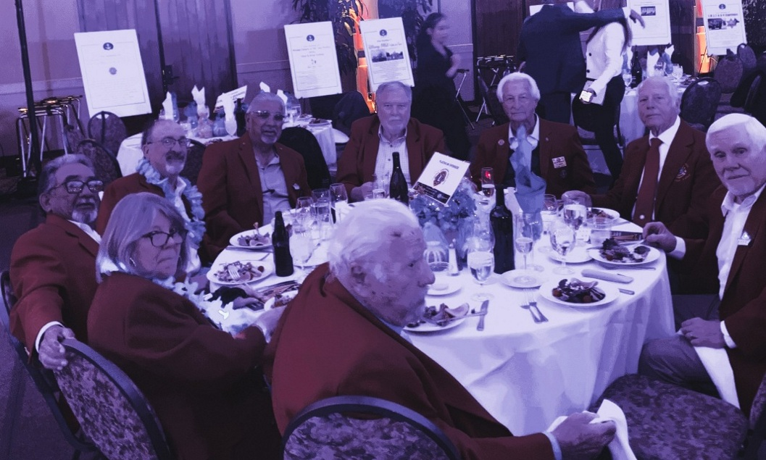

Boys & Girls Club Gala

Slide 33
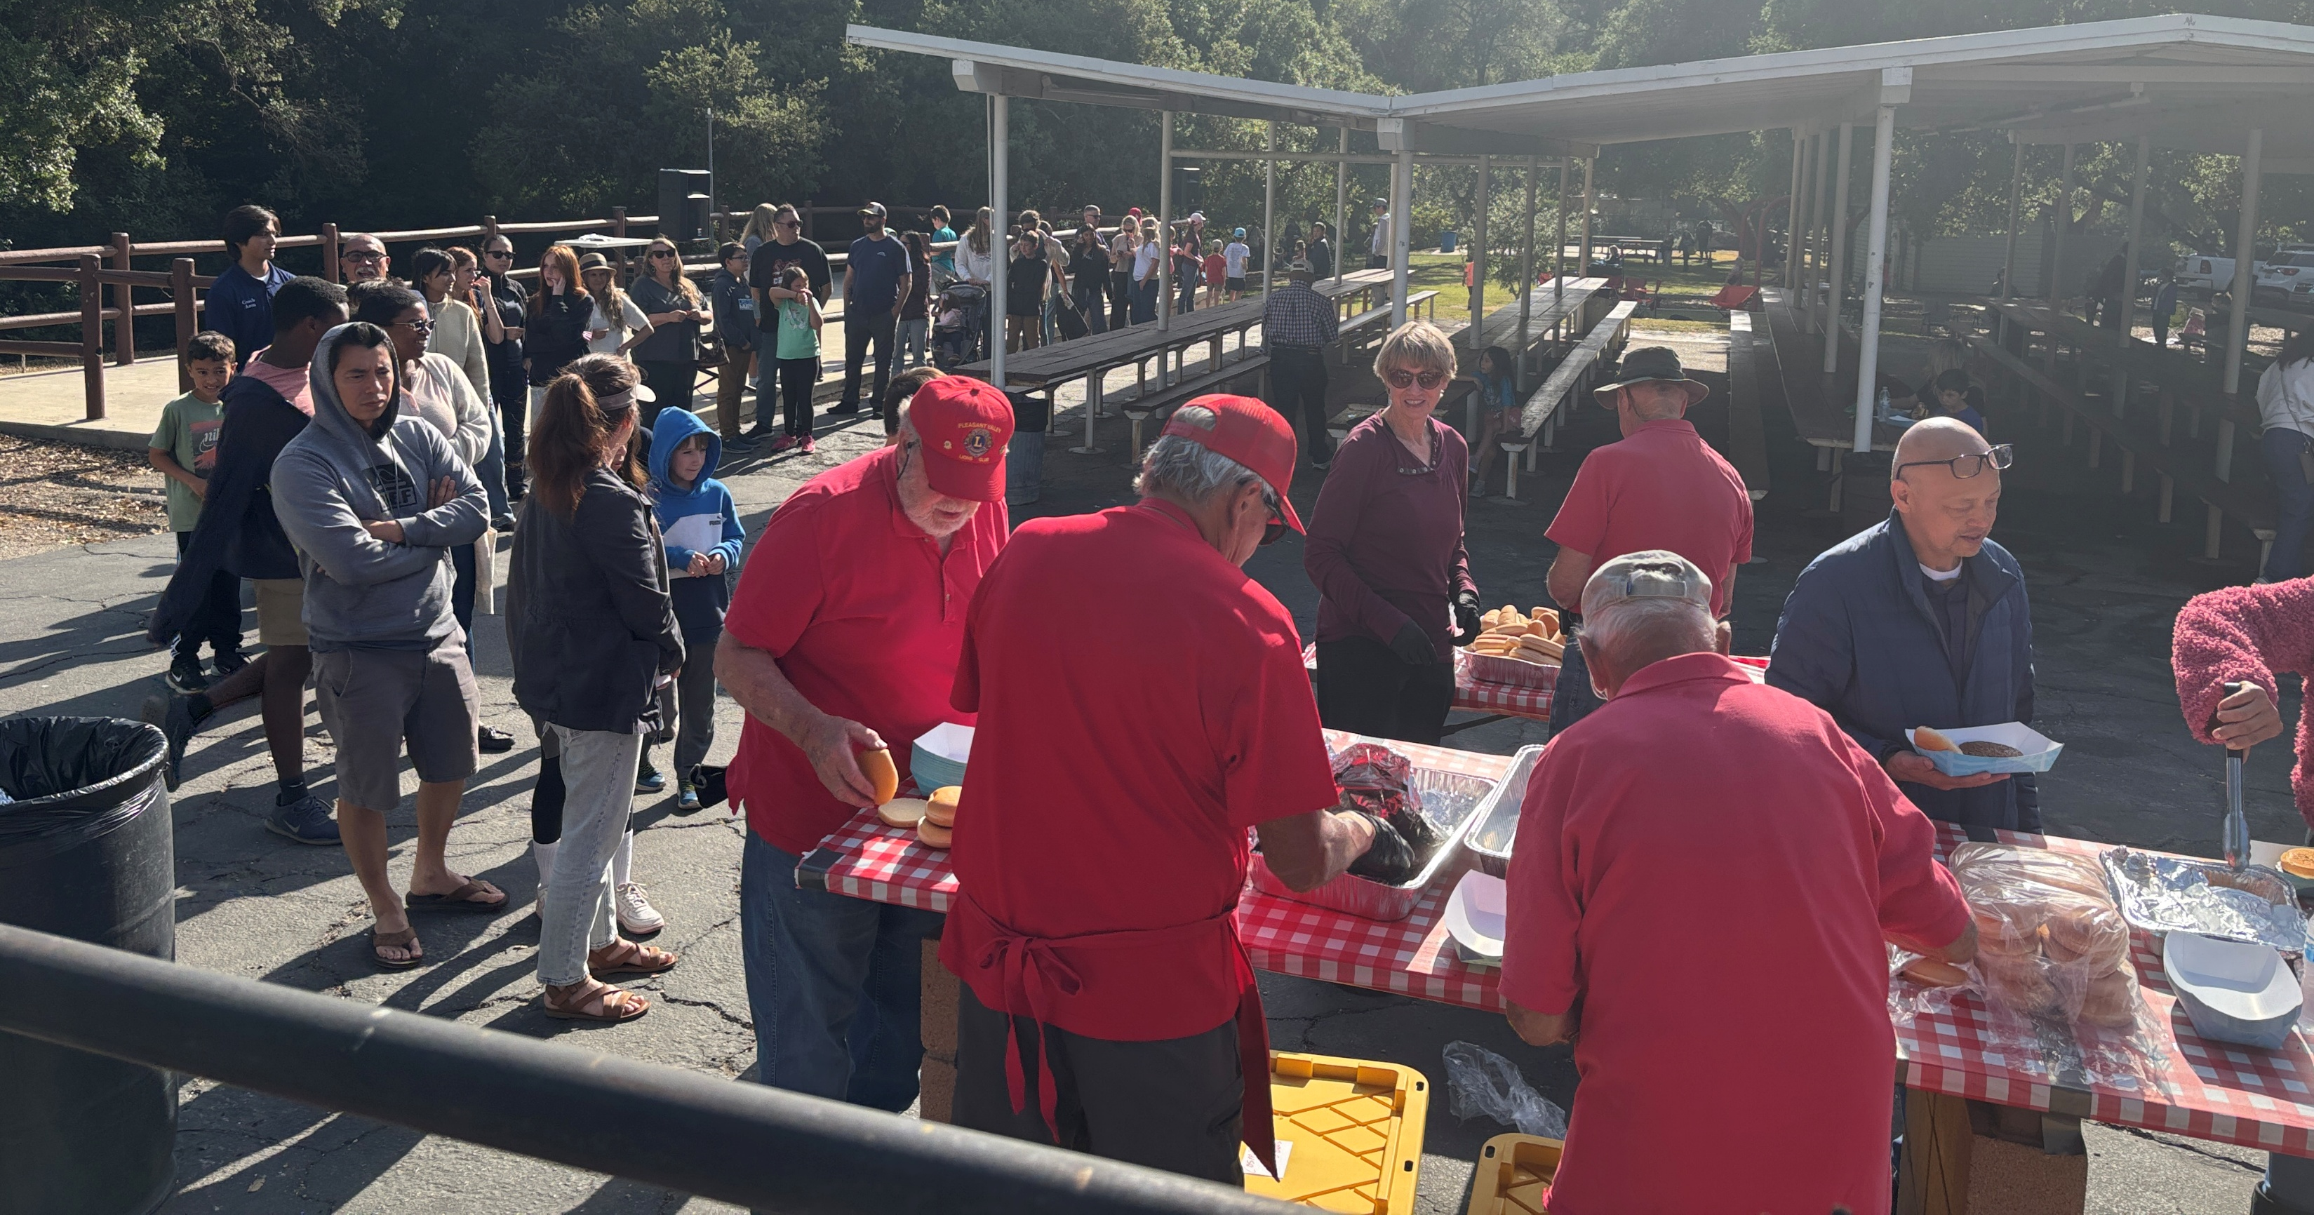
COSMOS Track Club BBQ for 500

Slide 34
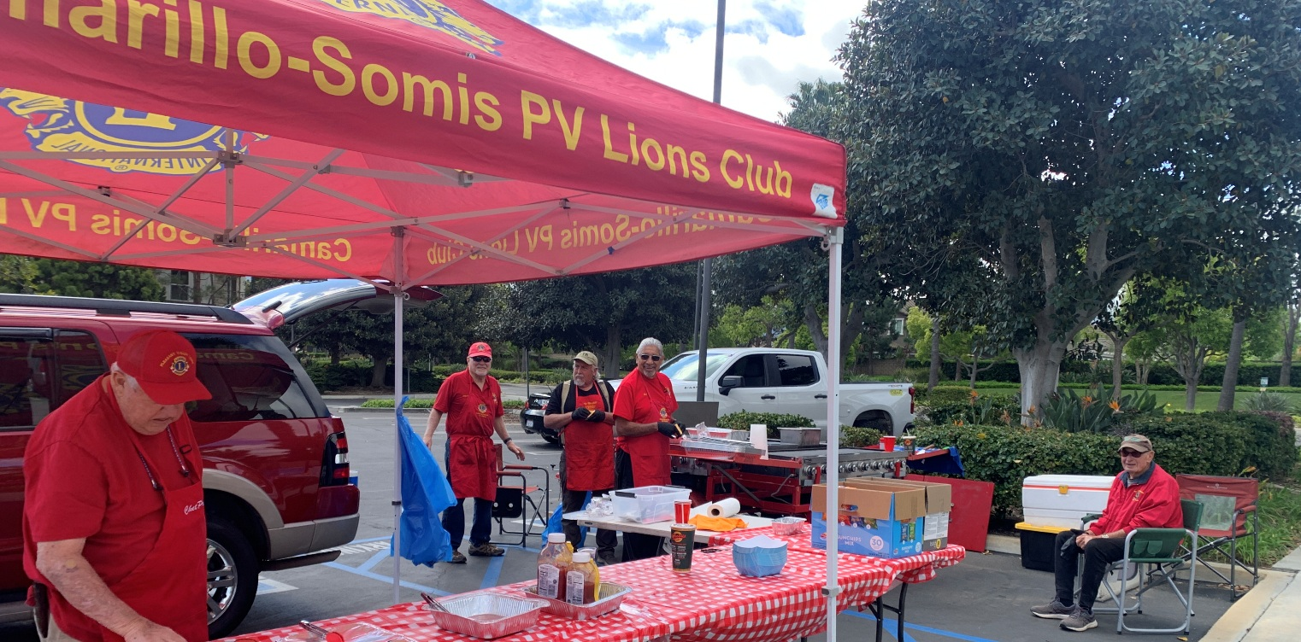
BBQ at YMCA for Firefighters

Slide 35
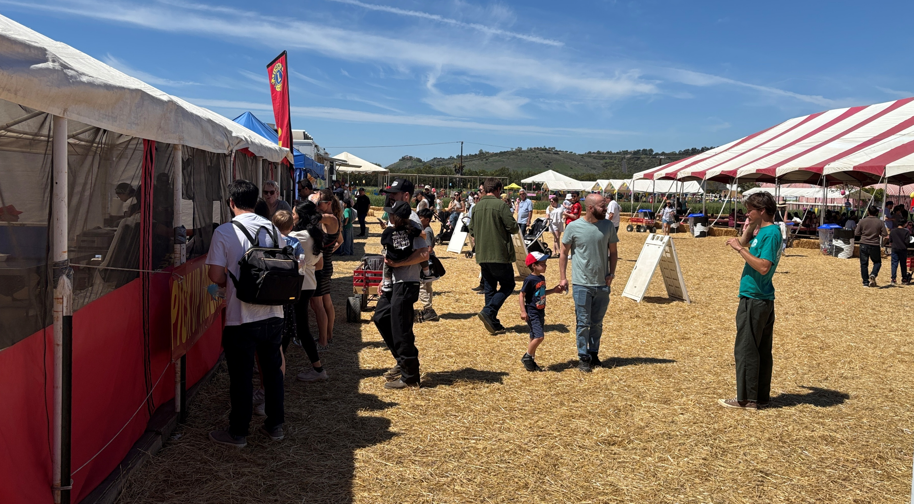
Easter Fest @ Underwood Farms

Slide 36
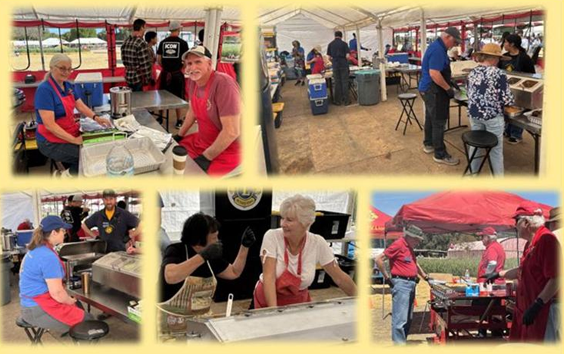
Easter Fest

Slide 37
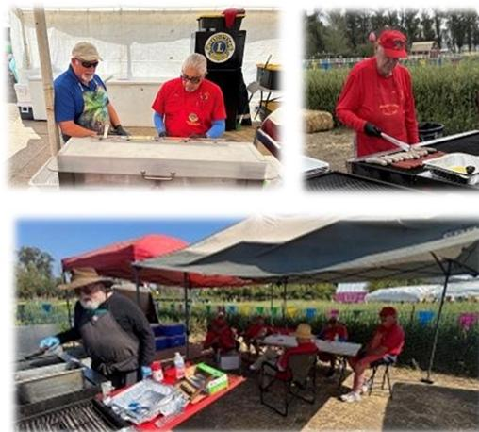
Easter Fest

Slide 38
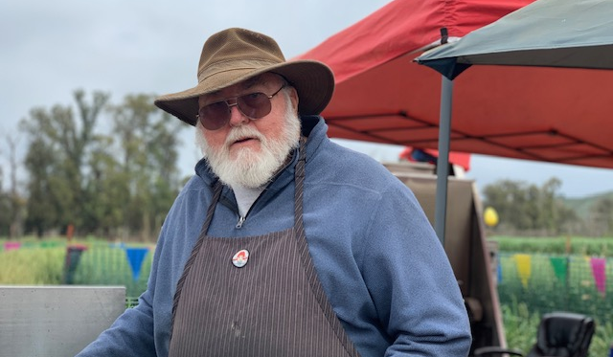
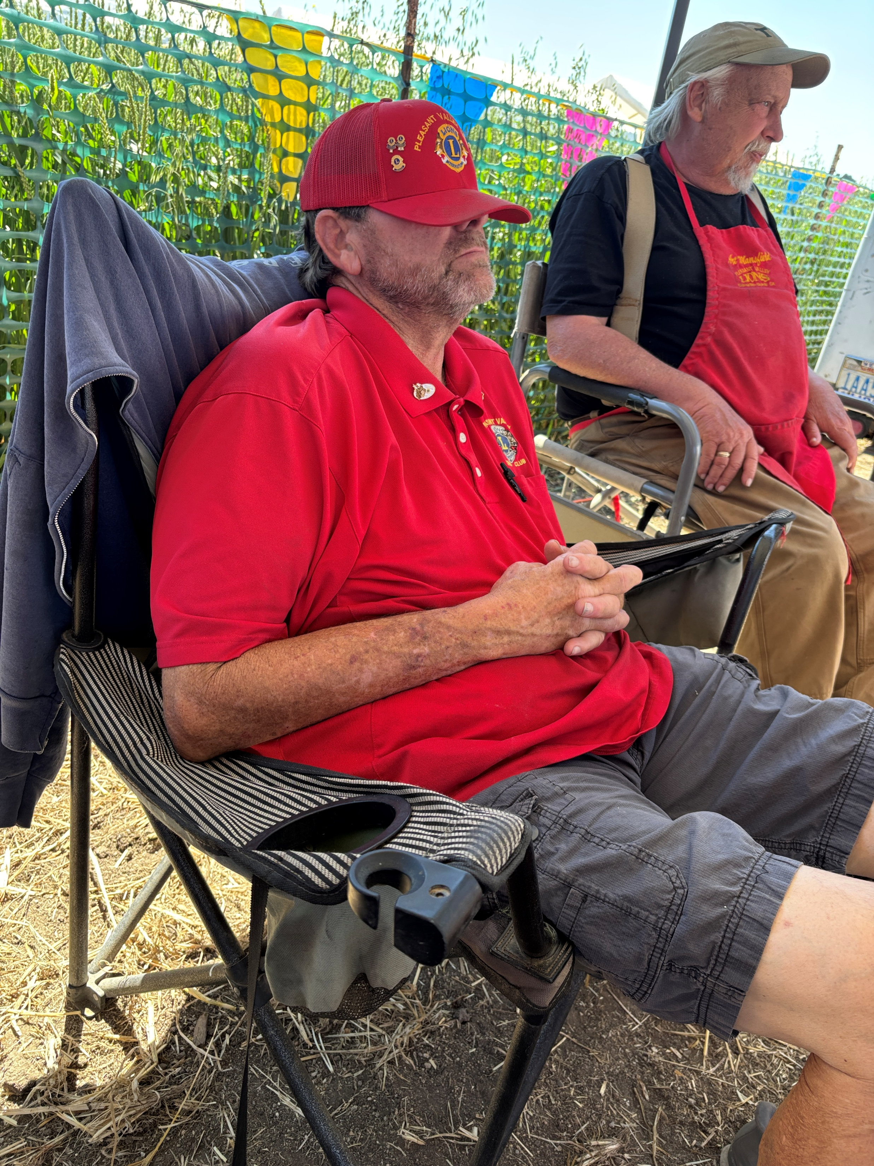
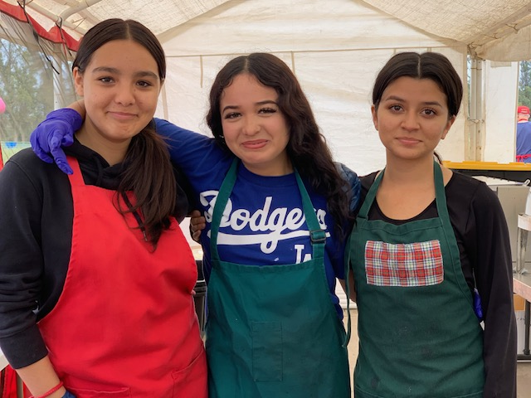
Easter Fest

Slide 39
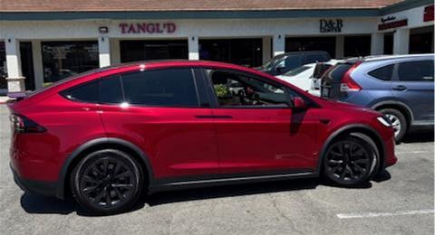
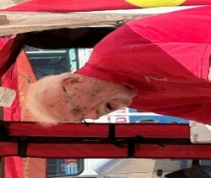
Lion Bill gets a Tesla

Slide 40

Diabetes Care Collaborative

Slide 41

Conejo Valley Disabilities Fair

Slide 42


Ventura County Fair Bingo

Slide 43

Don and Donna Award Dinner

Slide 44


Slide 45


Holiday Ball Drive

Slide 46

BumbleBee Golf Tournament

Slide 47

Harvest Festival @ Underwood Farms

Slide 48

Harvest Festival

Slide 49

Harvest Festival

Slide 50




Salvation Army Bellringer Christmas Campaign. Lions @ Ralphs Grocery.

Slide 51

Lloyd and Mike on Vacation

Slide 52


Slide 53

Lion Burgers for Cam High Baseball

Slide 54


Slide 55


Vision Screening @ Santa Paula - Lions Friends in Sight

Slide 56

Vision Screening at multiple schools in Ventura County

Slide 57

Golf Cart Donation to Miracle League of the 805

Slide 58


PV Lions Deliver Thousands of Eye Glasses to Lions Friends in Sight

Slide 59



MD4 Convention

Slide 60

For the Troops Banquet @ Reagan Library

Slide 61



Guide & Service Dog Graduation

Slide 62



Citizens Patrol/DART Recognition

Slide 63


