Slide 1


OUR 2020-2021 YEAR
MIKE NUNEZ, PRESIDENT
BRUCE JOCHUMS, 1st V.P., MIKE MORGAN, 2nd V.P.,
RUSS WHITE, SECRETARY, GEORGE GRAHAM, TREASURER AND YEARBOOK CHAIRMAN

Slide 2
OUR OFFICERS
AND
DIRECTORS

Slide 3
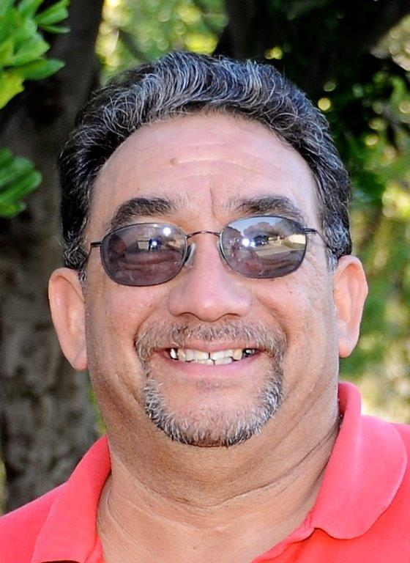
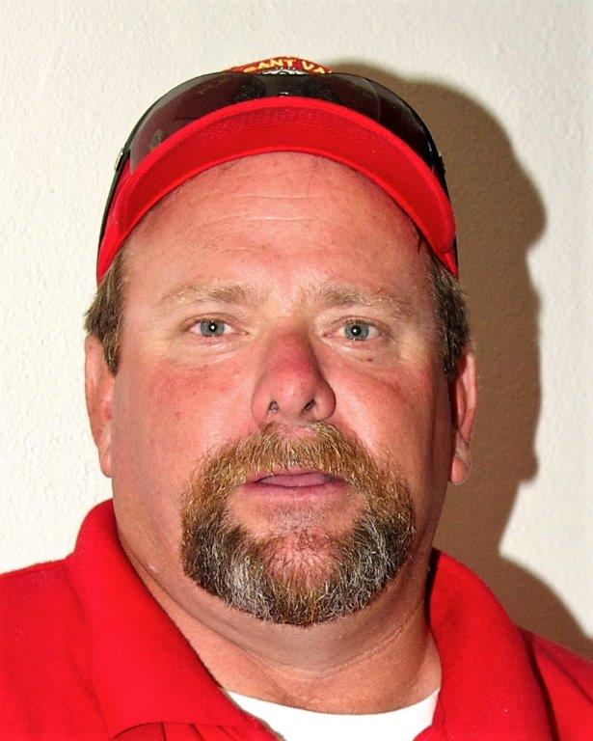
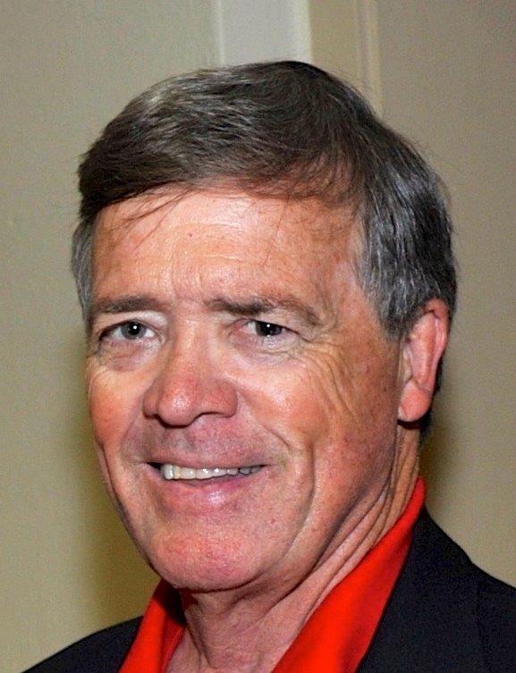
Club President
Mike Nunez
2nd
Vice
President
Bruce
Jochums
3rd
Vice
President
Mike
Morgan

Slide 4
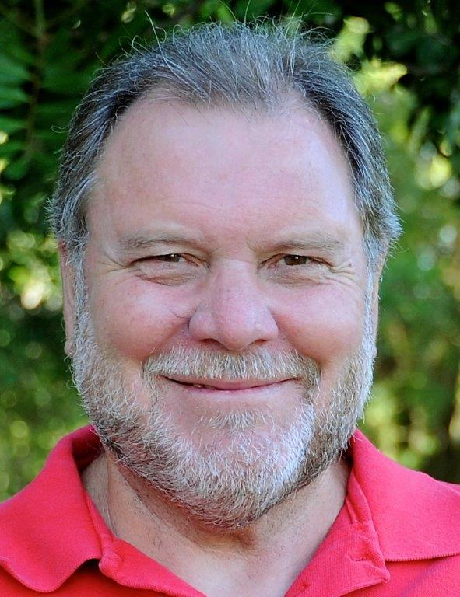
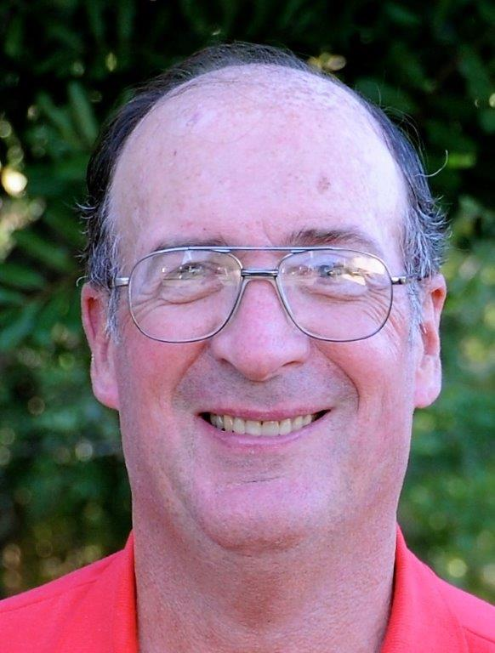
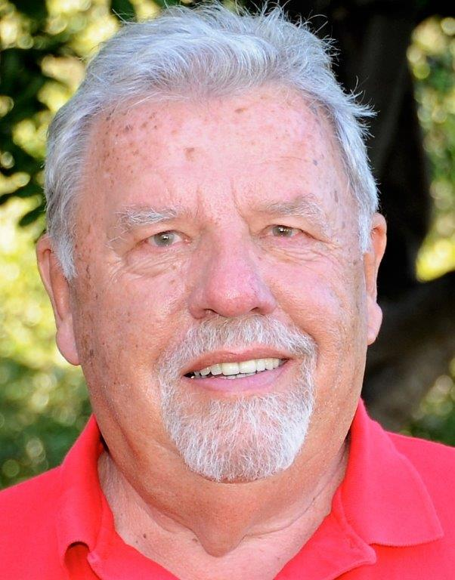
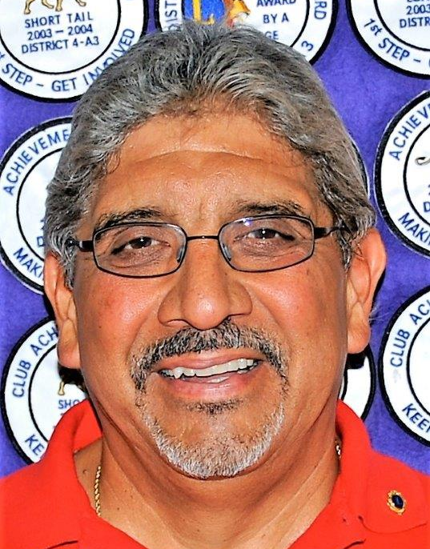
Club Secretary
Russ White
Club Treasurer
George Graham
Club Membership
Chair
Rich Cervantes
Club Service Chair
Bill Schulze

Slide 5
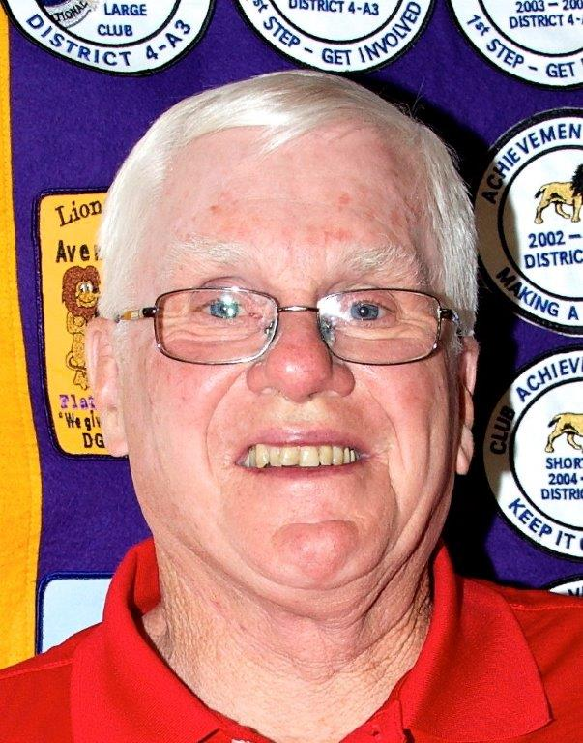
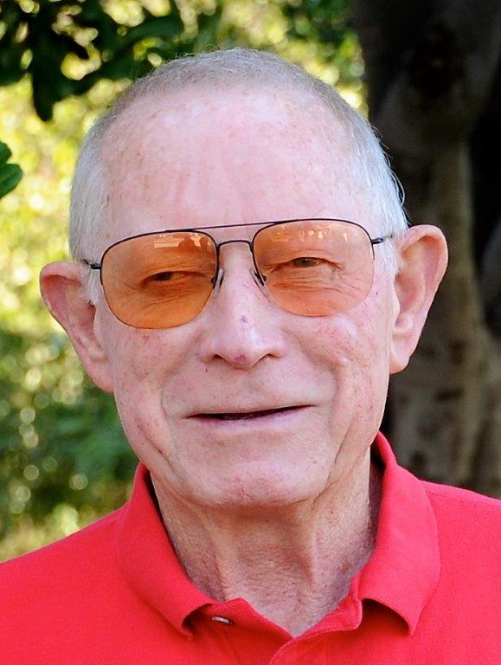
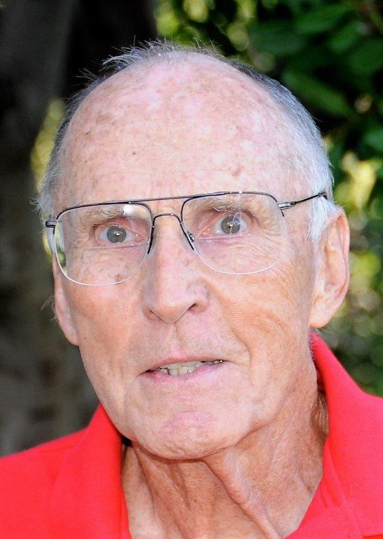
Tail Twister
Dick Bellman
Lion Tamers
Jack Eberts
Vincente Contreras
Tail Twister
Lloyd Christie

Slide 6
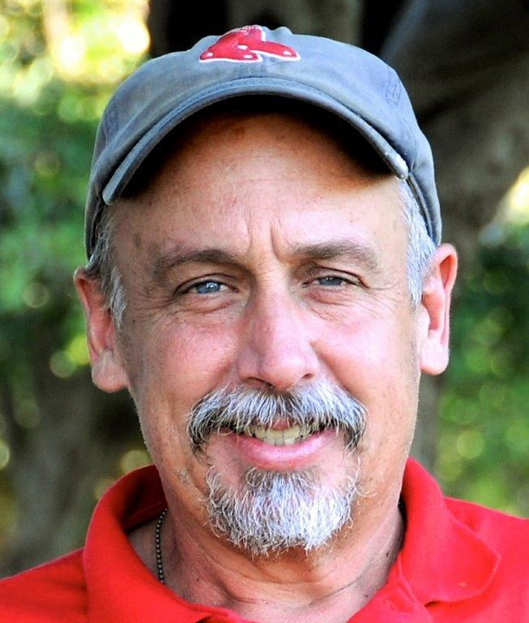
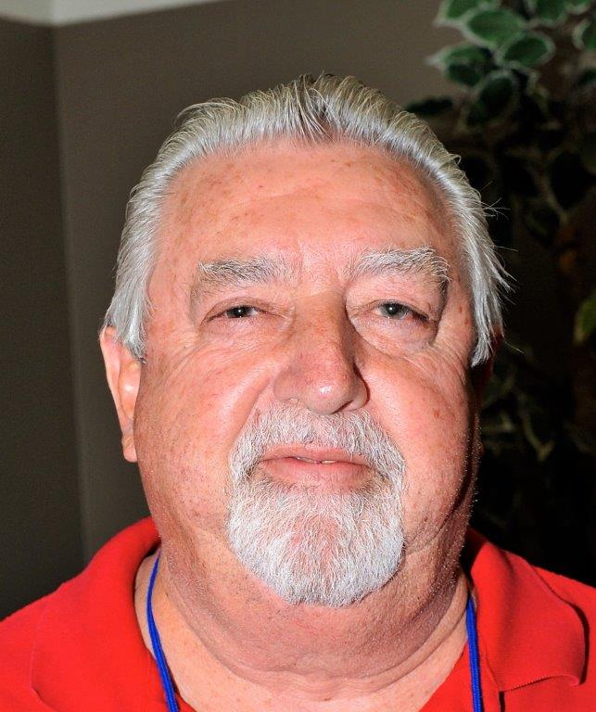
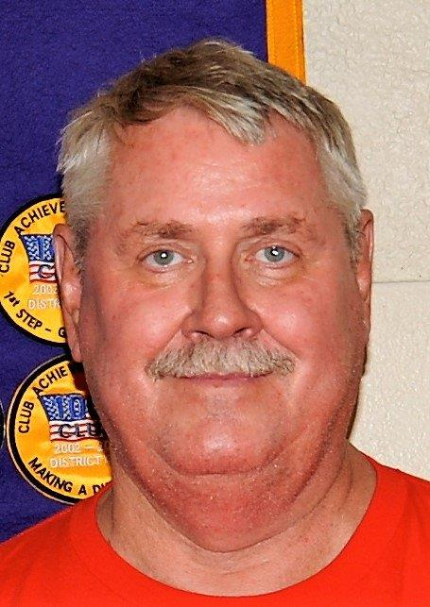
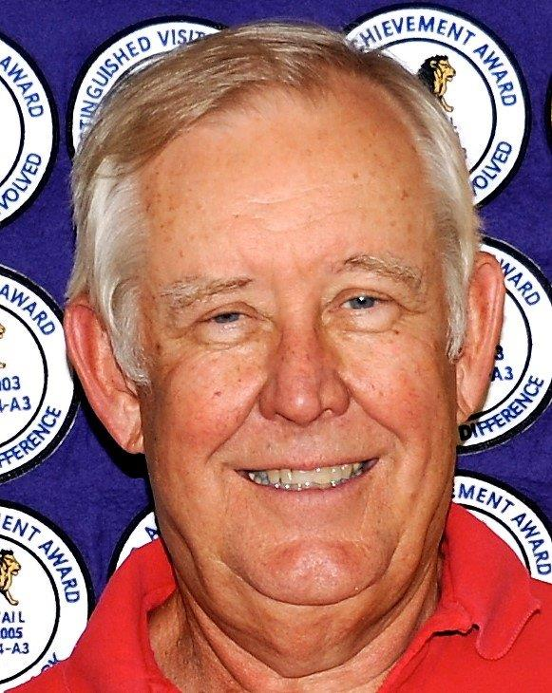
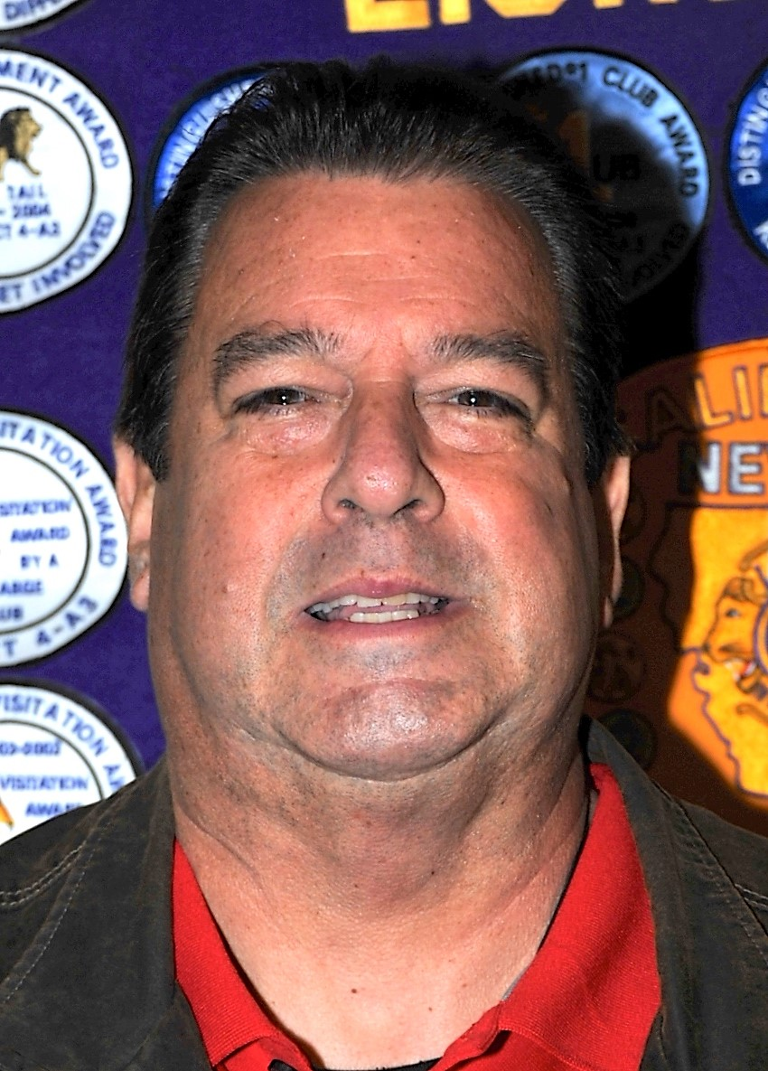
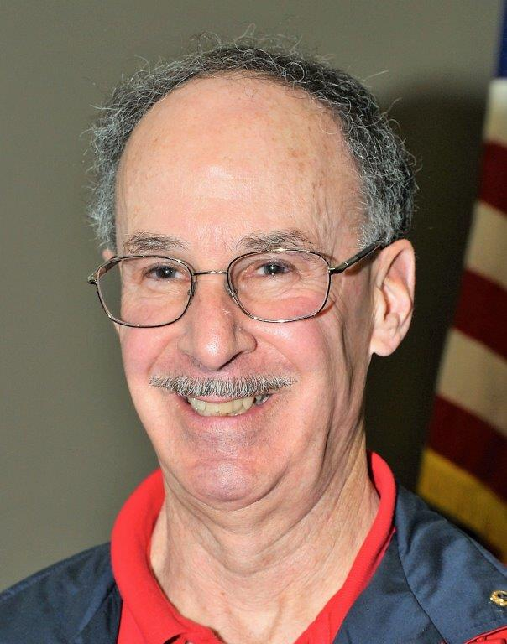
2nd Year Board Members
Art Mansfield
Chet Price
John Knittle
Joe Wetter
1st Year Board Members
Victor Martinez
Tom DeBardas
Bill Schulze
Kim Stephenson

Slide 7
OUR COMMUNITY SERVICE PROJECTS

Slide 8
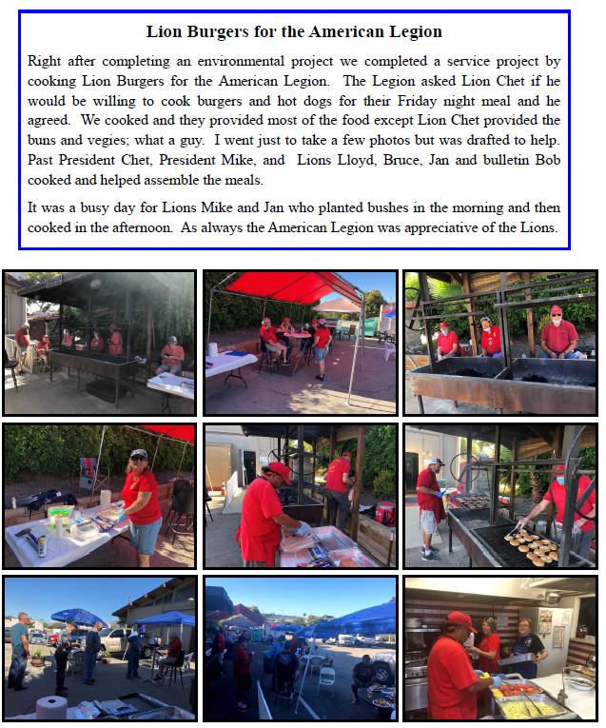

WE DIDN’T START THE YEAR OFF BY WORKING ON THE FIREWORKS SHOW AS IN PAST YEARS
BUT WE DID SEVERAL OTHER PROJECTS LIKE DOING LIONBURGERS FOR THE AMERICAN LEGION

Slide 9

IT’S BEEN A TOUGH YEAR FOR FUNDRAISING
OUR BIGGEST FUNDRAISER--
SELLING FOOD AT UNDERWOOD’S FAMILY FARM
HARVEST FESTIVAL
PARKING CARS AT
THE VENTURA COUNTY FAIR
SELLING FOOD AT
UNDERWOOD’S EASTER FESTIVAL

Slide 10
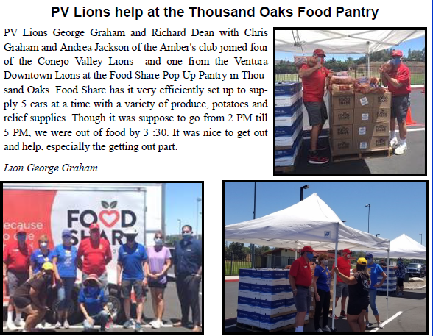
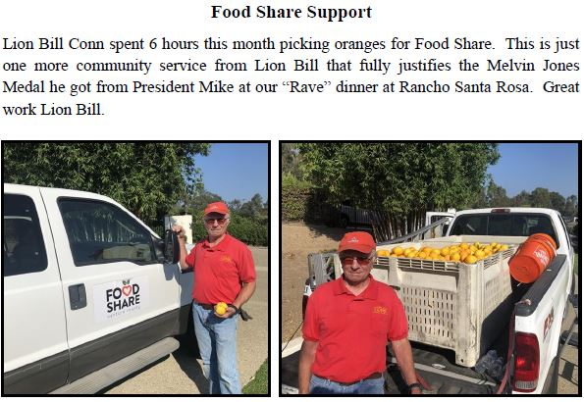
WE HELPED FOOD SHARE SEVERAL WAYS ON DIFFERENT DAYS

Slide 11
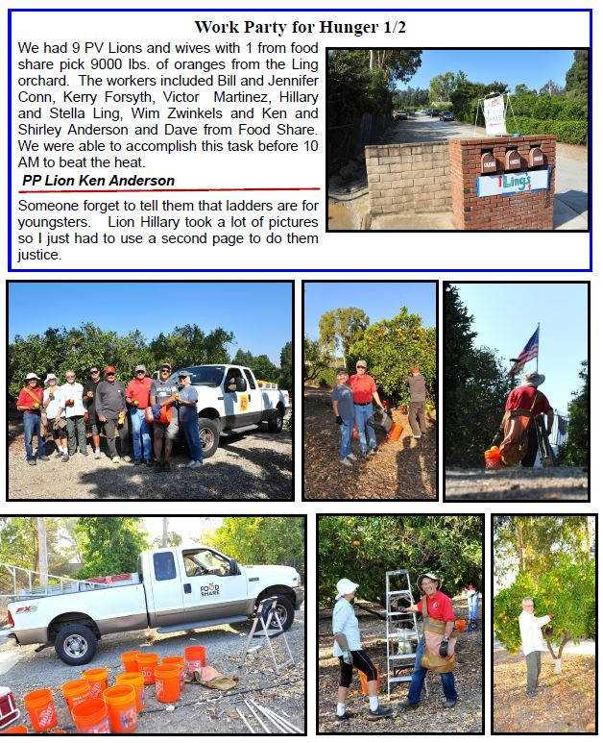
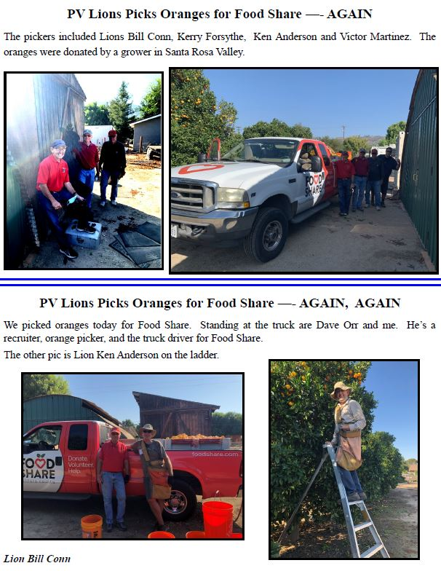

Slide 12
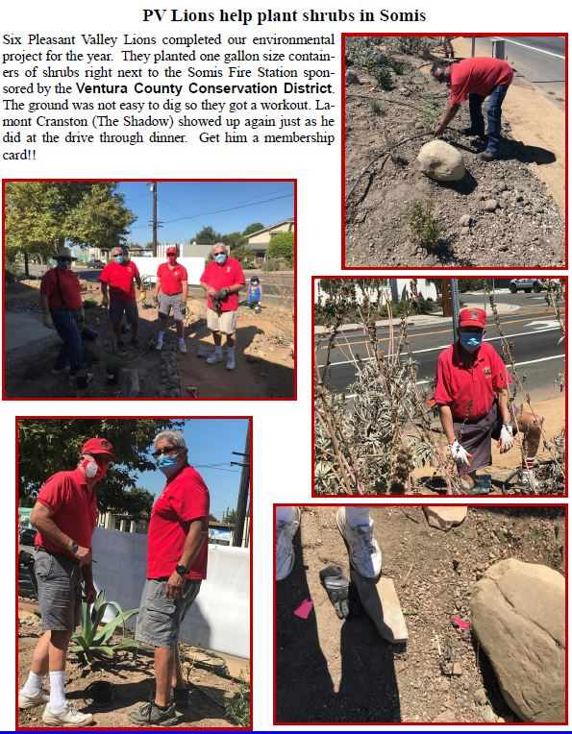
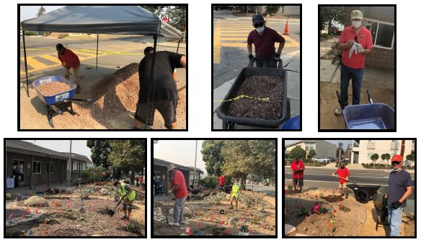
WE PLANTED SHRUBS FOR THE VENTURA COUNTY CONSERVATION DISTRICT

Slide 13
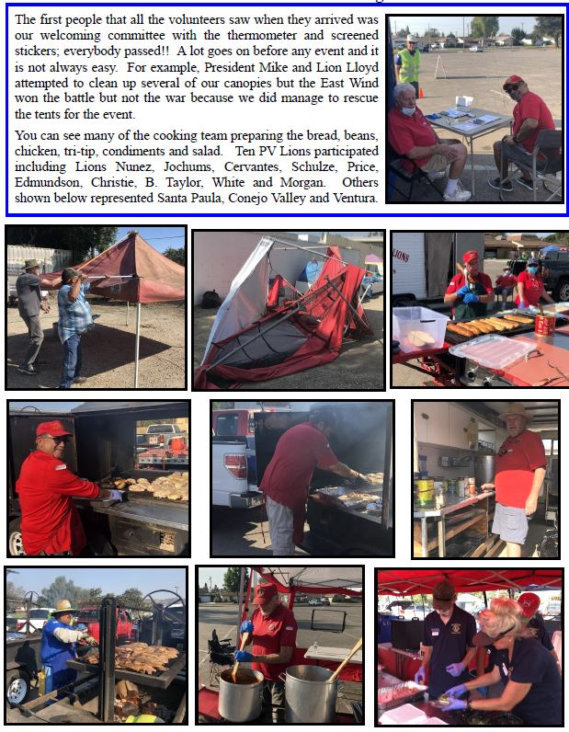
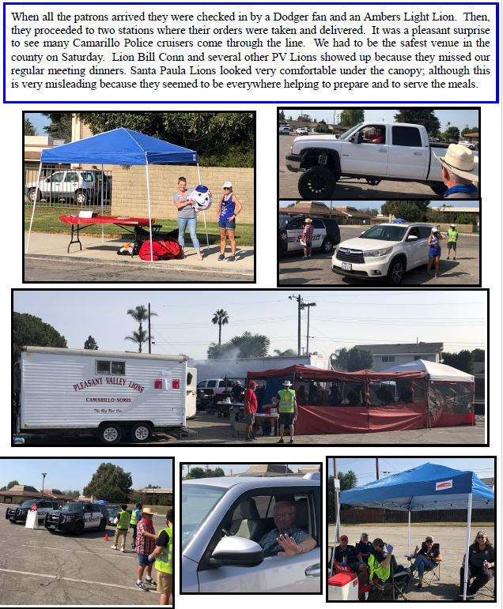
WE COOKED UP AND SERVED TRI-TIP AND CHICKEN TO RAISE MONEY FOR THE MIRACLE LEAGUE BASEBALL DIAMOND PROJECT

Slide 14
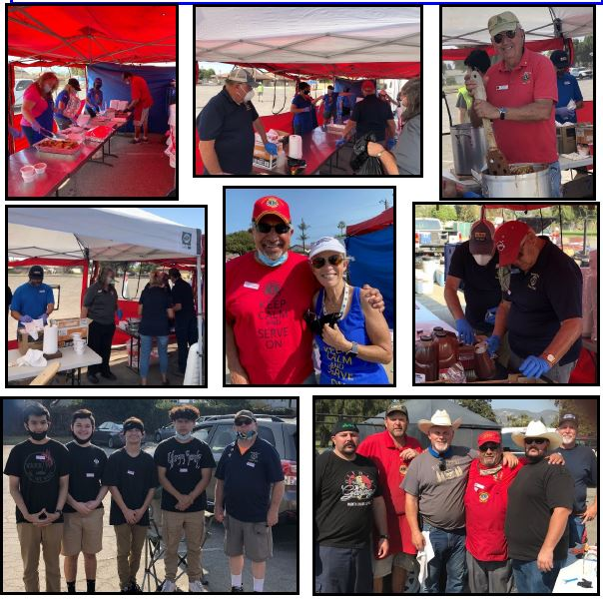
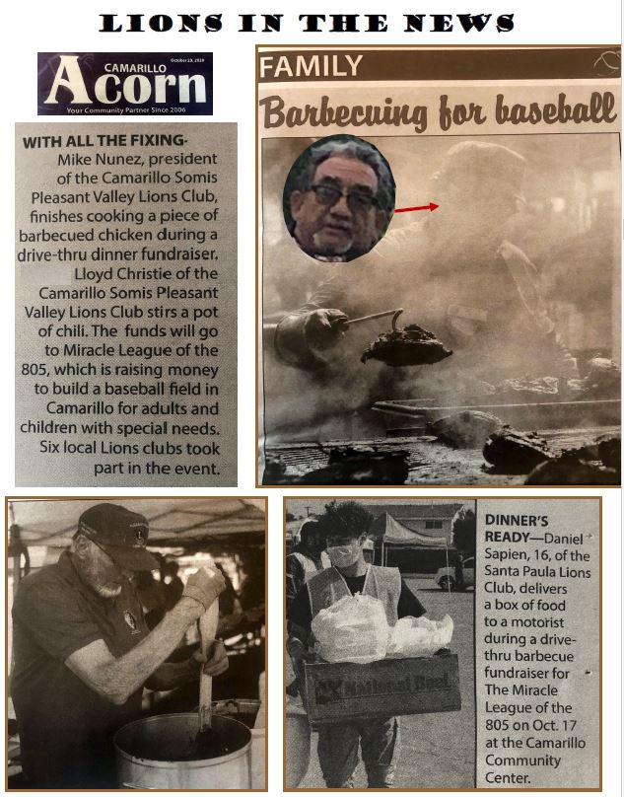
RAISING FUNDS FOR THE MIRACLE LEAGUE BASEBALL PROJECT WAS A FUN AND NEWS WORTHY EVENT

Slide 15

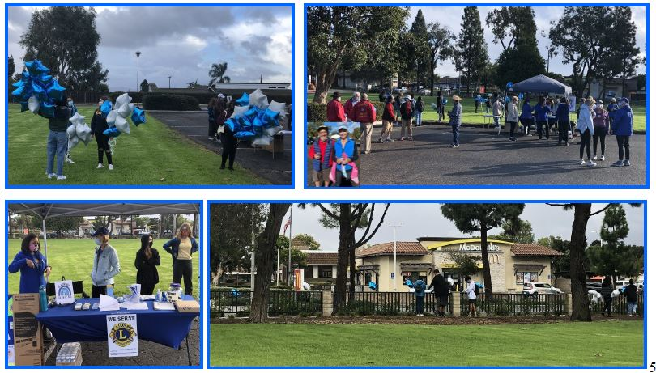
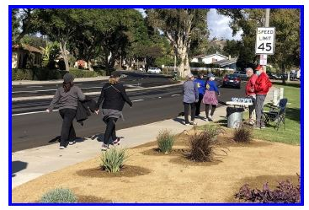
THE DIABETES WALK RAISED FUNDS FOR THE CITY OF HOPE DIABETES PROJECT.
WE HELPED SET UP THE DIABETES WALK THEN MANNED THE INTERSECTIONS OF THE THREE MILE ROUTE.

Slide 16
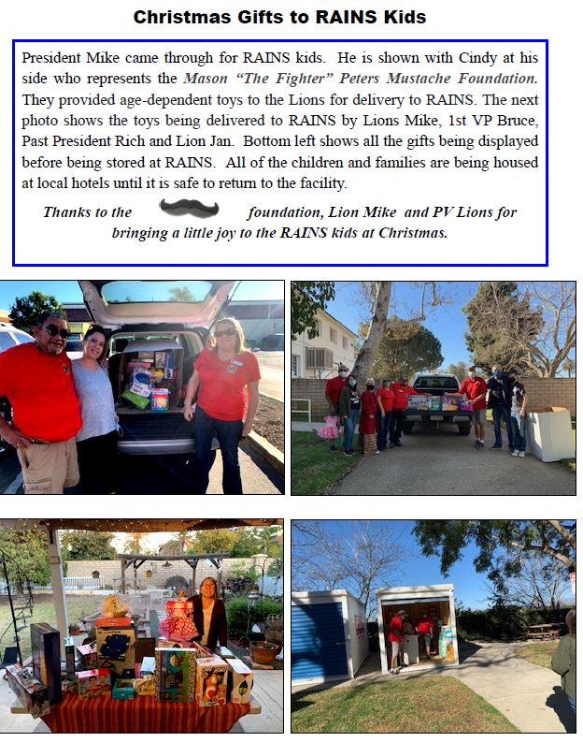
THOUGH WE COULDN’T SEE THE KIDS FROM RAIN IN PERSON, WE GAVE THEM CHRISTMAS GIFTS THANKS TO HELP FROM THE MASON PETERS MUSTACHE FOUNDATION

Slide 17

DESPITE LOSING OUR BIGGEST FUNDRAISERS,
WE PUT TOGETHER A GREAT EVENT COMBINING HELPING THE VISUALLY IMPAIRED BY COLLECTING GLASSES (AND HEARING AIDS) AND SUPPORTING PEDIATRIC CANCER PROGRAMS

Slide 18
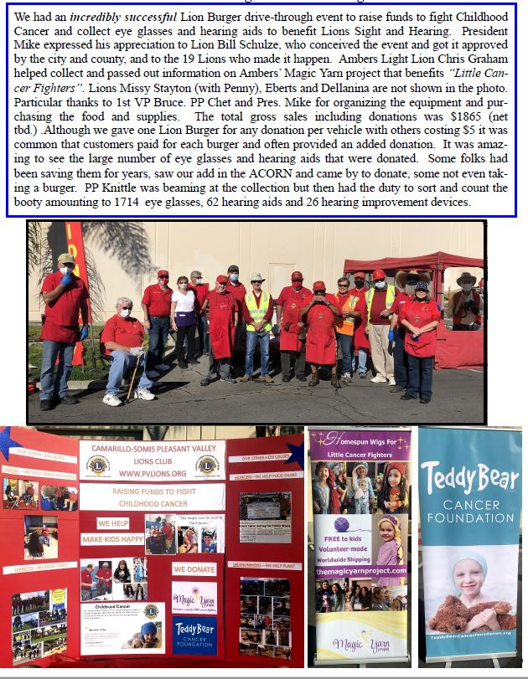
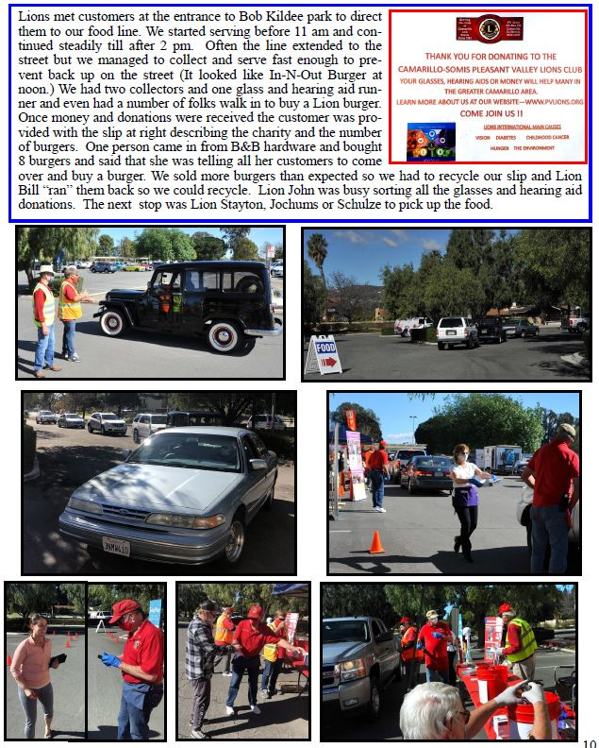

Slide 19
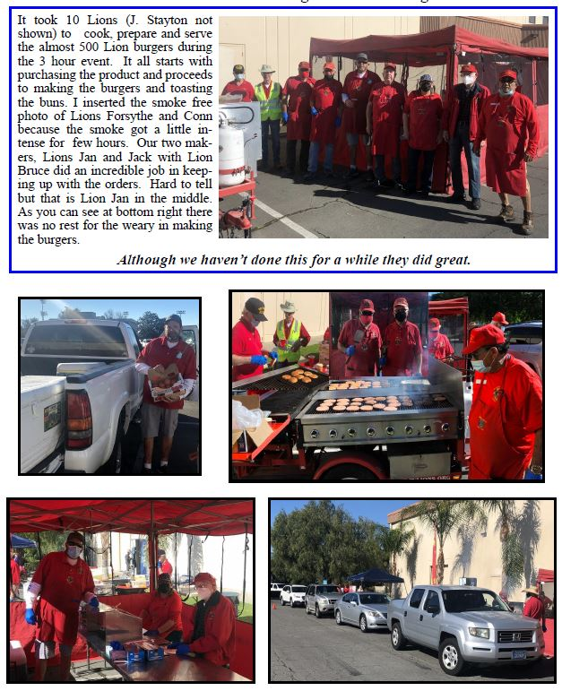
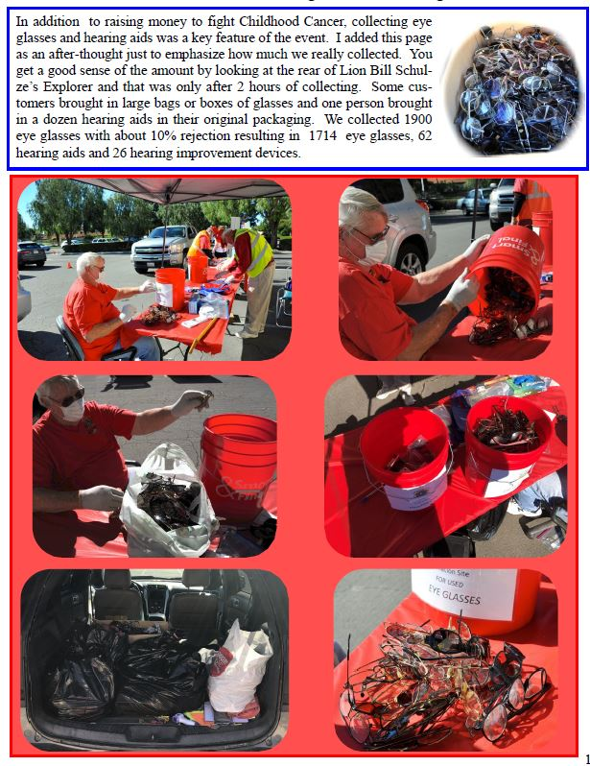

Slide 20

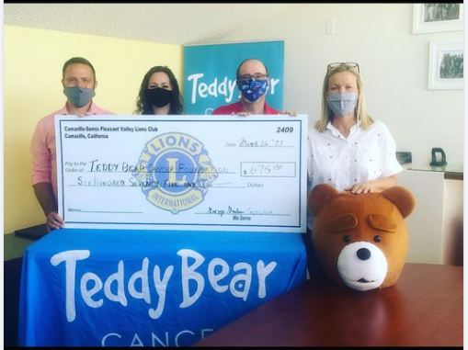
Collecting 1700 pairs of glasses and selling lionburgers netted the teddy bear cancer foundation
a nice $675 donation.

Slide 21

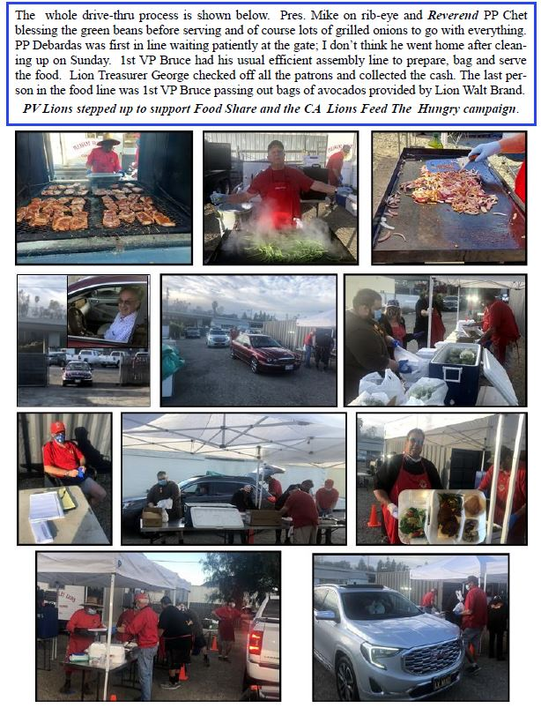
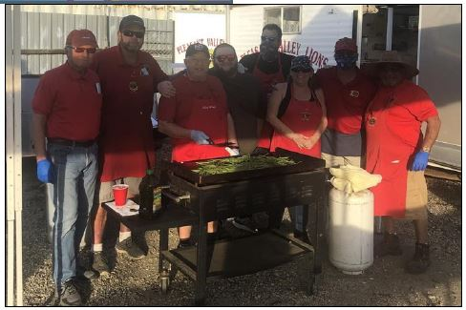
WE WEREN’T FINISHED HELPING FOOD SHARE AND THE CALIFORNIA LIONS FEED THE HUNGRY CAMPAIGN
WE DID A DRIVE THRU DINNER OF RIB EYE STEAK AND FIXINGS

Slide 22
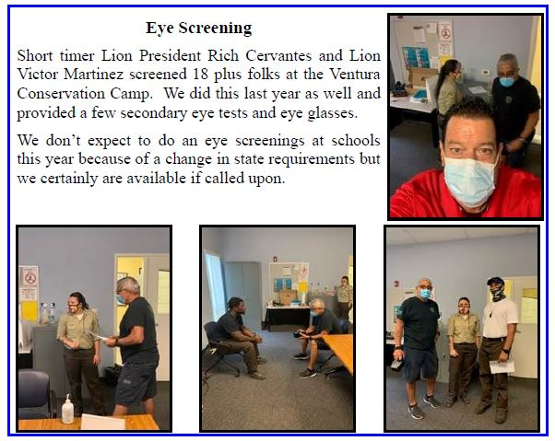
COVID-19 KEPT US FROM DOING EYE SCREENINGS AT NUMEROUS SCHOOLS, A MULTI-DAY EVENT THAT WE ARE VERY PROUD OF. BUT WE DID SCREEN 18 PEOPLE AT THE VENTURA CONSERVATION CAMP

Slide 23
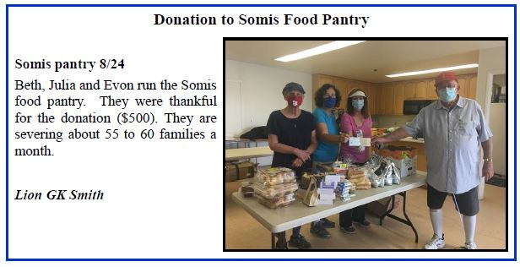
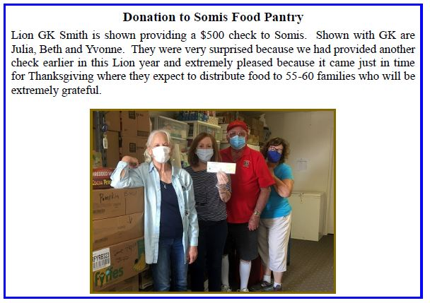
THOUGH OUR CHARITY BUDGET WAS SLIM THIS YEAR DUE TO CANCELLED EVENTS, WE STILL DONATED TO THE SOMIS FOOD PANTRY

Slide 24
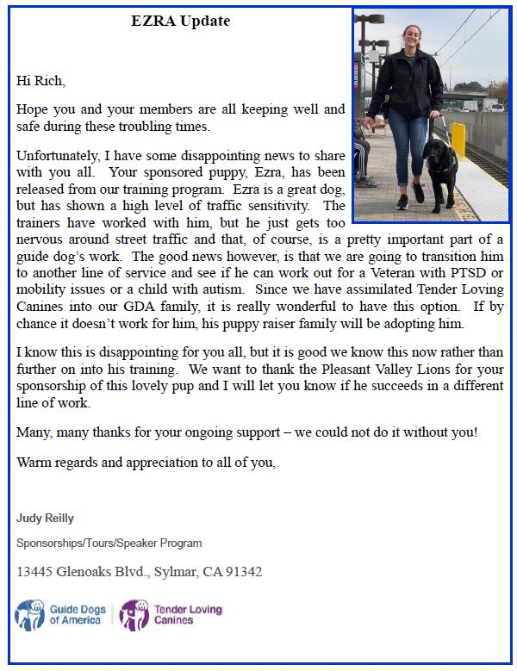
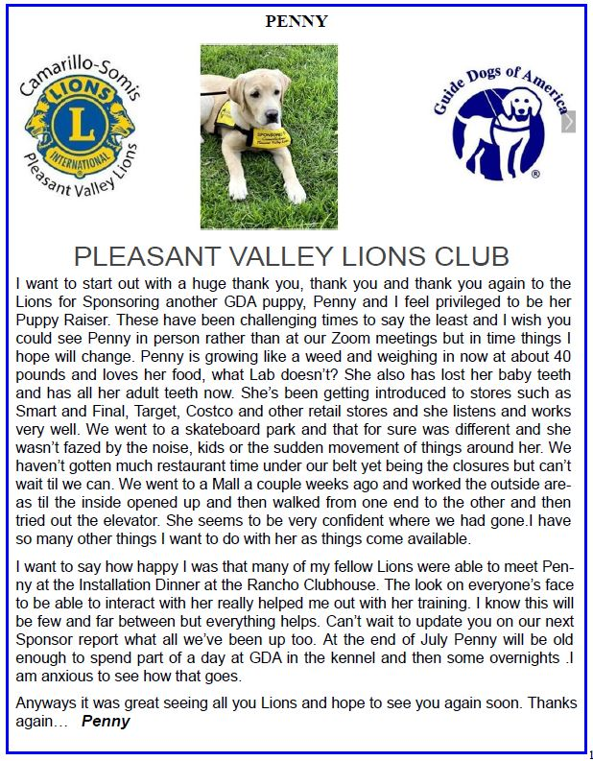
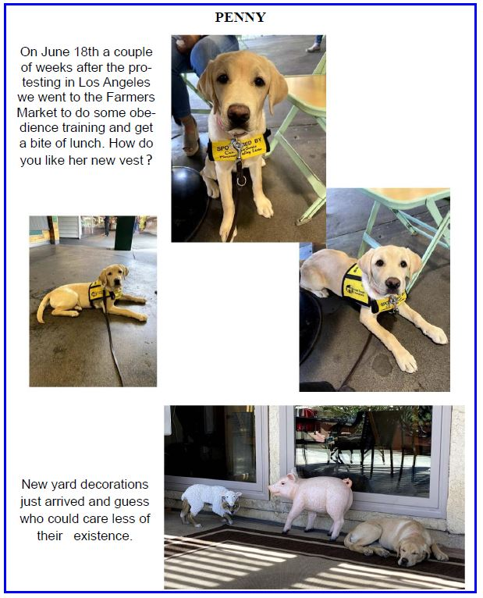
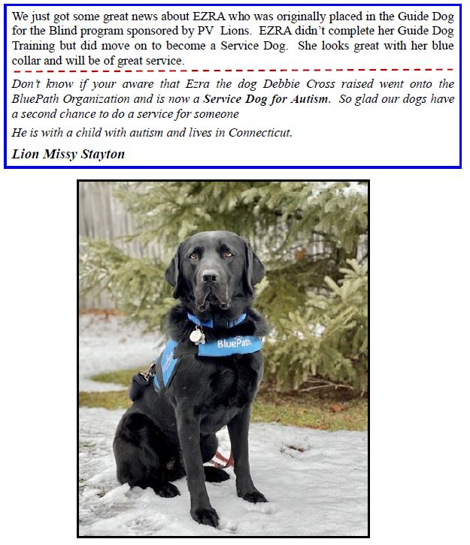
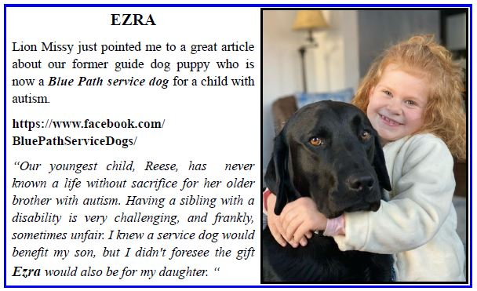
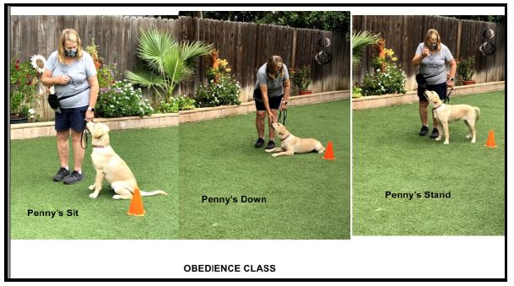
The dogs we sponsored were very successful this year—ezra, as a blue path service dog for a child with autism, and penny made great strides on her way to guide dog school.

Slide 25
OUR
DISTRICT ACTIVITIES

Slide 26
WE DID ATTEND THE DISTRICT MEETINGS
THIS YEAR
AND LIKE EVERYONE ELSE…
VIA…
ZOOM
WE JUST DIDN’T TAKE ANY PICTURES

Slide 27
OUR
YOUTH ACTIVITIES

Slide 28
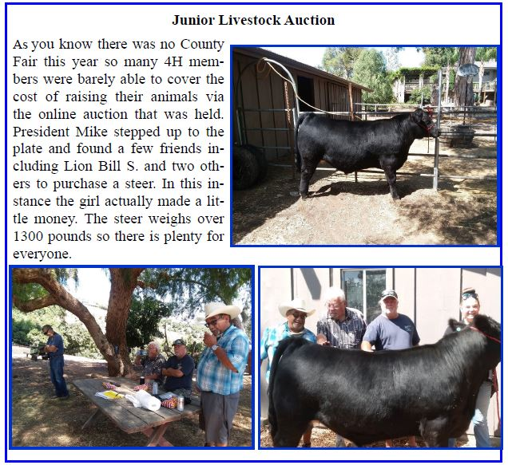
WITH NO COUNTY FAIR THIS YEAR, THERE WAS ONLY AN ONLINE AUCTION YET WE MANAGED TO HELP A 4-H STUDENT SELL HER STEER.

Slide 29
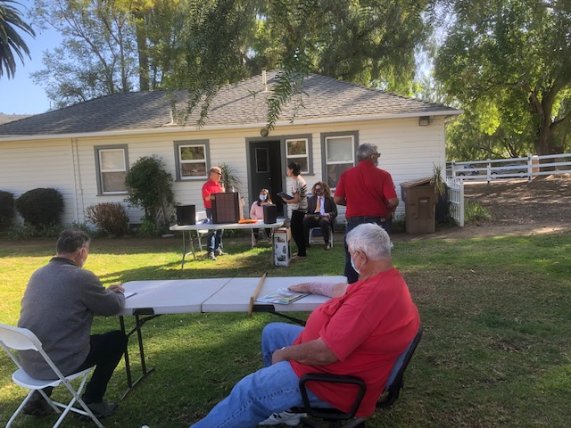
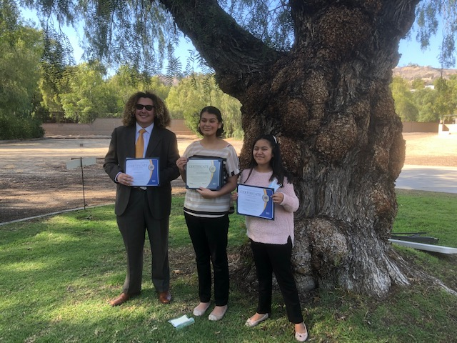
THIS YEAR’S STUDENT SPEAKER CONTEST WAS A BIT DIFFERENT THAN PREVIOUS YEARS.
IT WAS OUTDOORS.
BUT IT WAS STILL A VERY GOOD COMPETITION.

Slide 30
OUR
CLUB’S SOCIAL ACTIVITIES

Slide 31
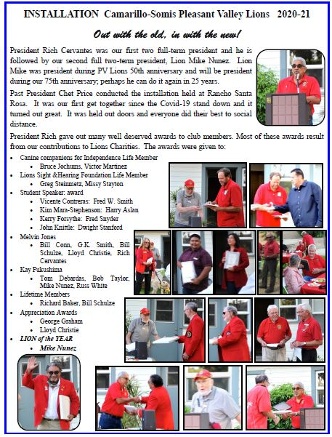


WE JUST COULDN’T STAY AWAY !!
WE GATHER OUTDOORS TO INSTALL OUR NEW BOARD

Slide 32

WE JOINED
THE AMBER’S LIGHT LION CLUB, SORT OF INDOORS, A BARN ANYWAY, FOR THEIR INSTALLATION.

Slide 33




AH, REGULAR MEETINGS DURING COVID—MOSTLY BY ZOOM BUT WE DID GET OUTSIDE!

Slide 34







Slide 35



BOARD MEETINGS WERE THE SAME—BY ZOOM AND IN PERSON

Slide 36



MORE BOARD MEETINGS BY ZOOM

Slide 37






TOUGH YEAR THAT IT WAS, WE WERE APPRECIATED WITH THANK YOU LETTERS

Slide 38

THANK YOU TO LION BOB TAYLOR
FOR HIS EXCELLENT NEWSLETTERS
AND TO ALL THE OTHERS WHO SUPPLIED THE PHOTOS FOR
EVERYTHING THAT HAPPENED
THIS YEAR

